Slide 1

Music
Knowledge Organisers

Slide 2
Spring 1

Slide 3
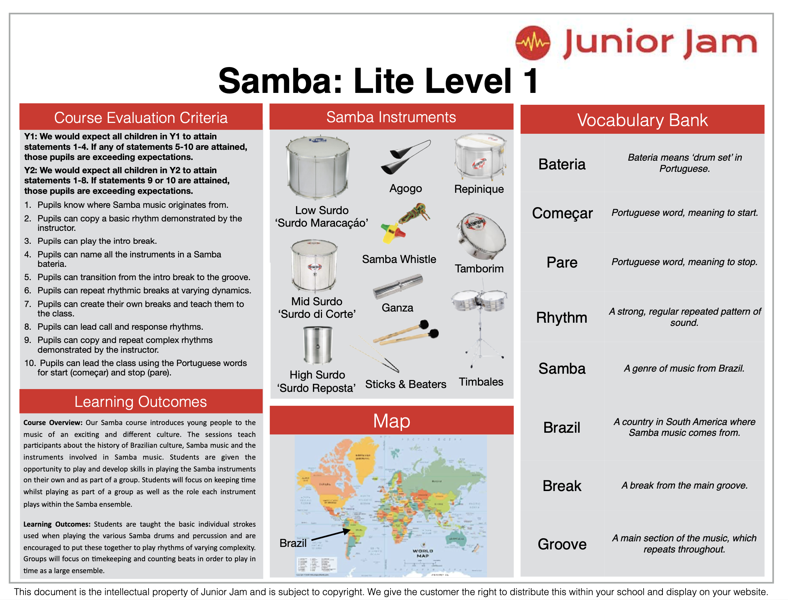

Slide 4


