Slide 1

French
Knowledge Organisers

Slide 2
Spring 1

Slide 3
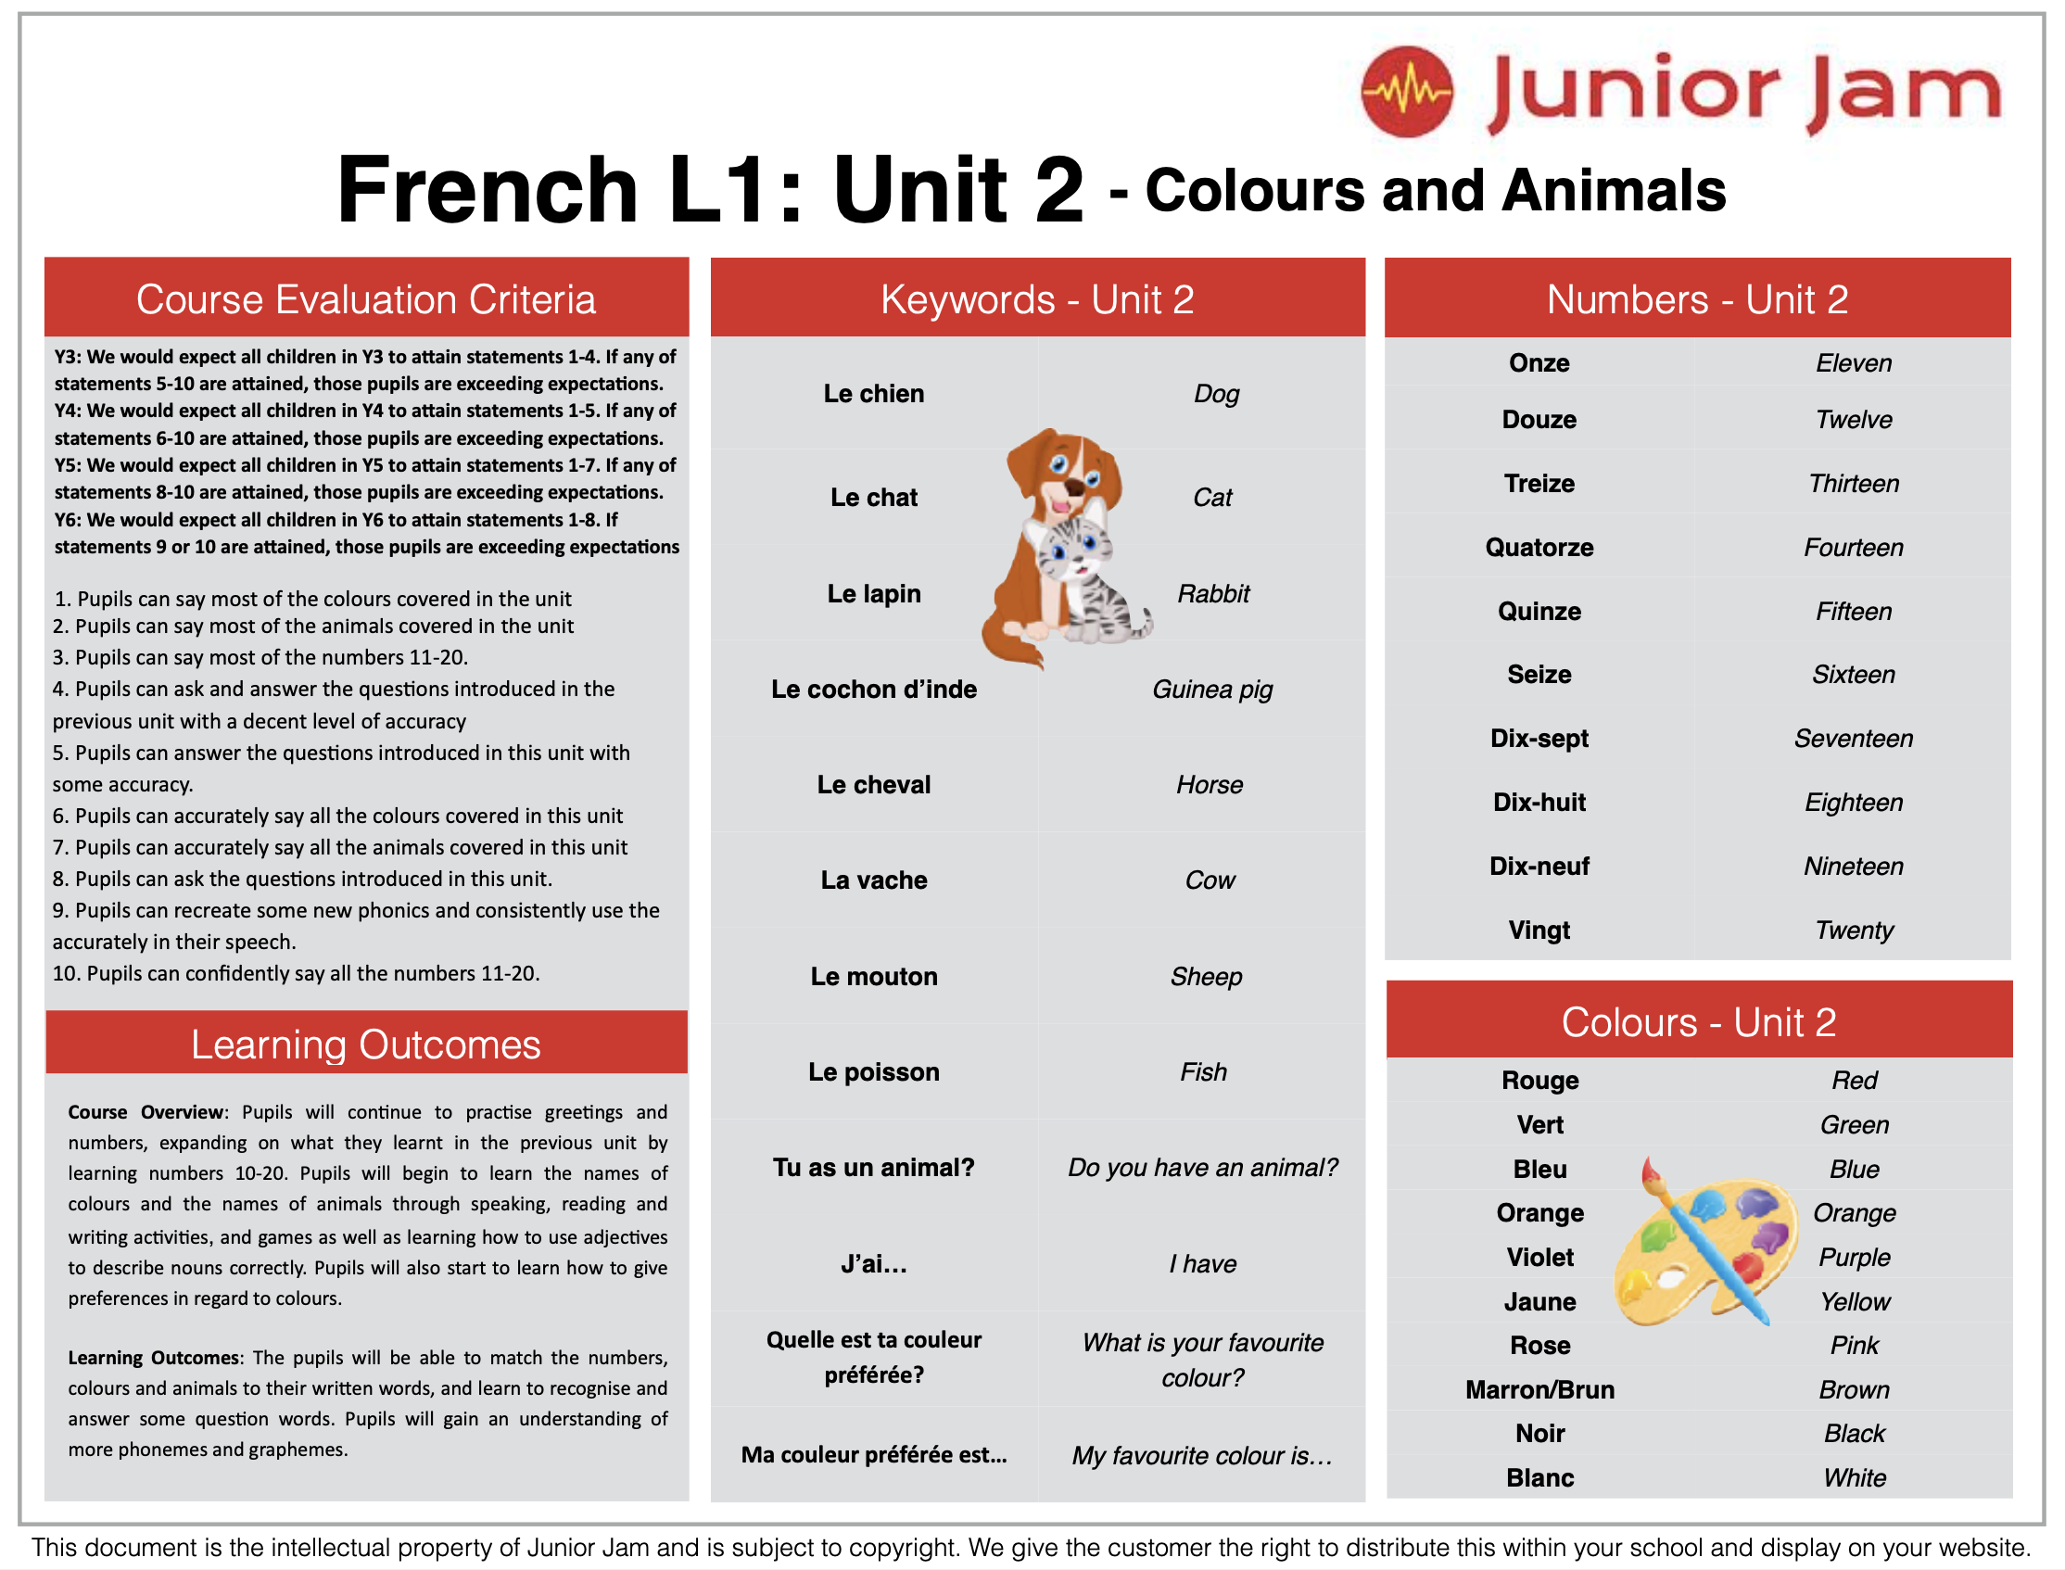
Year 3 & 4

Slide 4
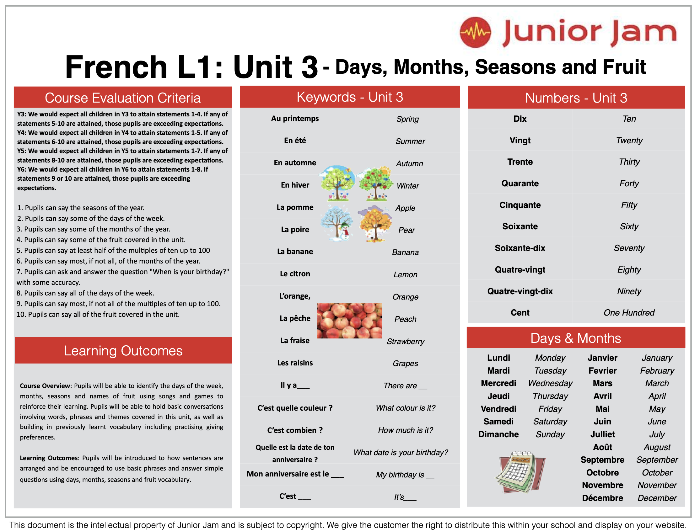
Year 4

Slide 5
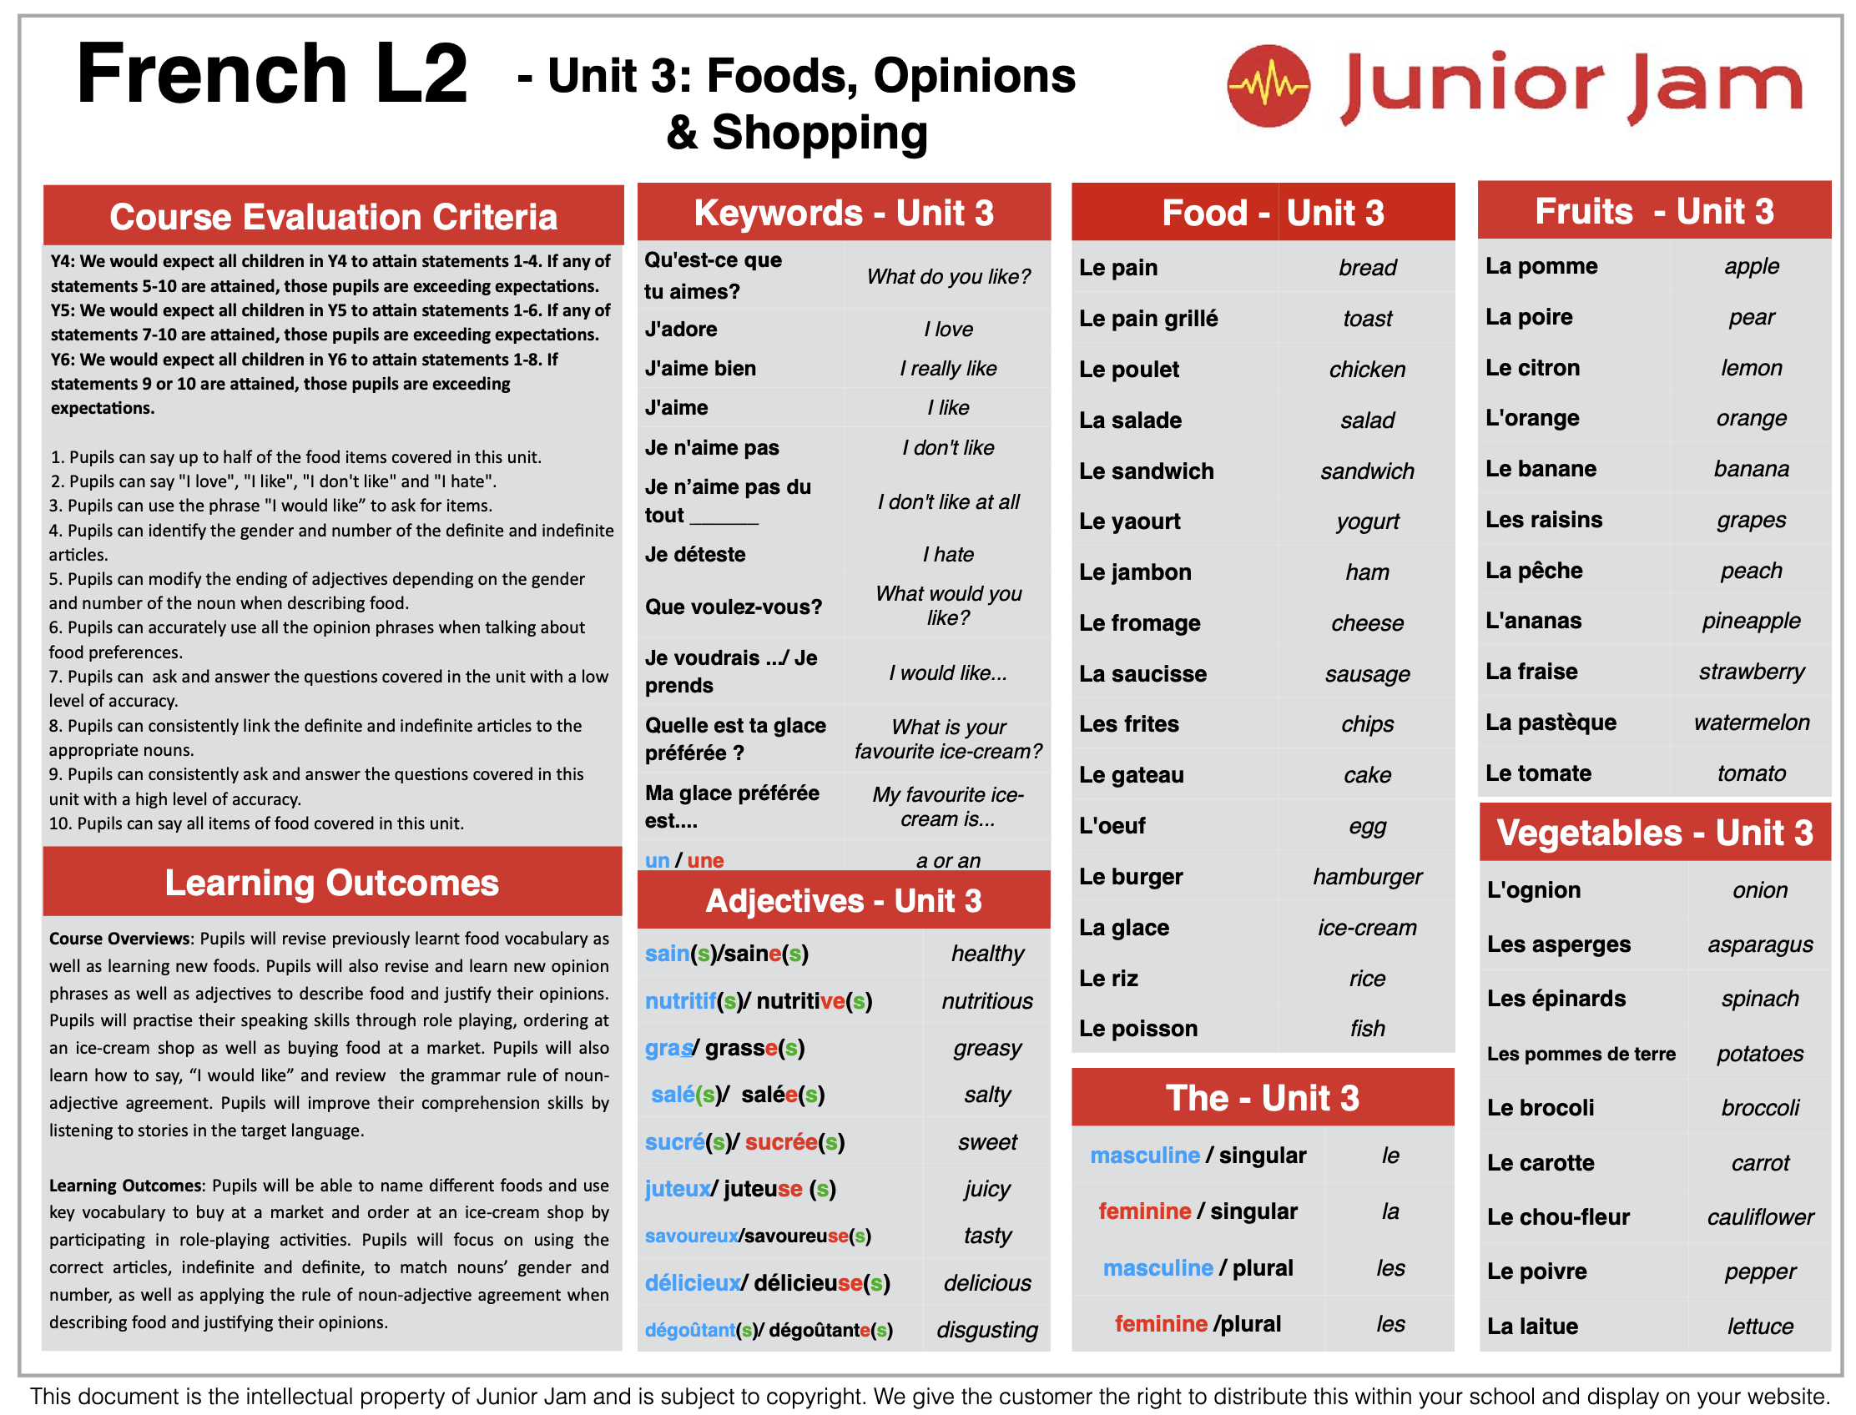
Year 5

Slide 6
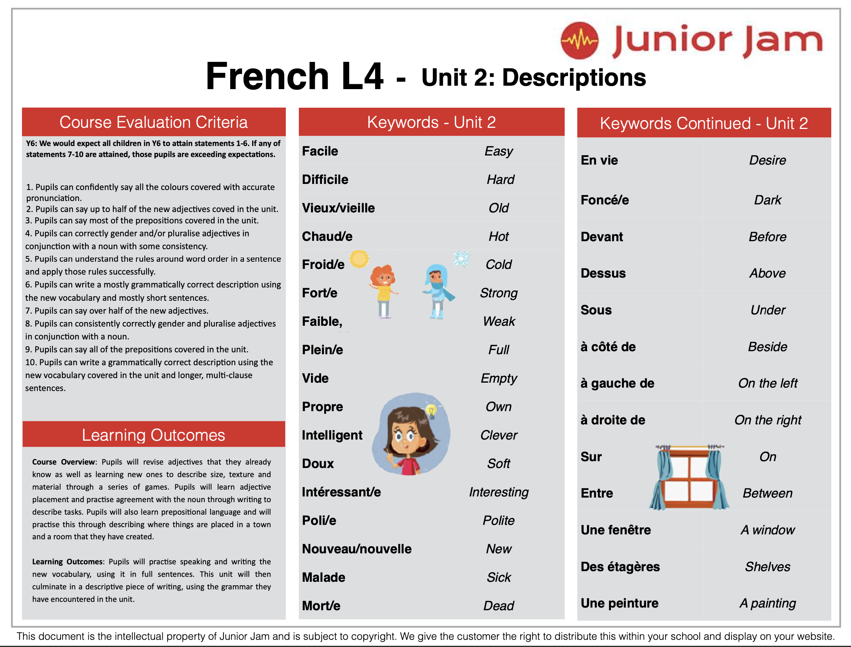
Year 6

Slide 7
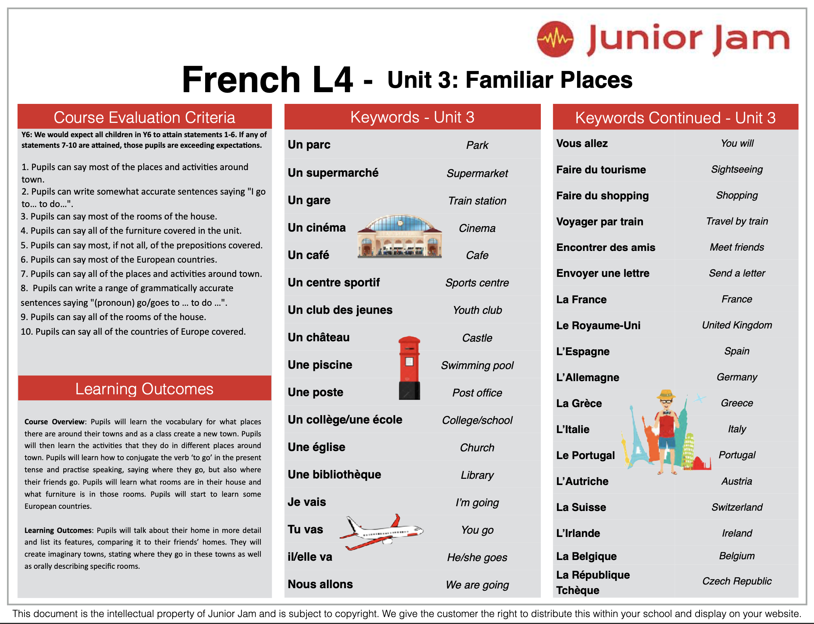
Year 6

