Slide 1

Computing

Slide 2
Computing Policy
Policy Title | Computing Policy
Ratified by | Jason Newsham
Subject Leader | Helen Lawton
Date ratified
Review date
Named governor

Slide 3
Role of the Subject Leader
The KS2 Computing Subject Leader is responsible for leading and developing the Computing curriculum across Key Stage 2, ensuring that it is engaging, progressive, and aligned with the National Curriculum. They support teachers with planning, resources, and professional development, while monitoring the quality of teaching and learning through activities such as lesson observations, work scrutiny, pupil voice, and assessment analysis. The subject leader also evaluates pupil progress, promotes effective use of technology, oversees online safety education, and works with senior leaders to identify strengths and areas for improvement. Through these responsibilities, they help ensure that all pupils develop the knowledge, skills, and confidence needed to become competent and responsible users of technology.

Slide 4
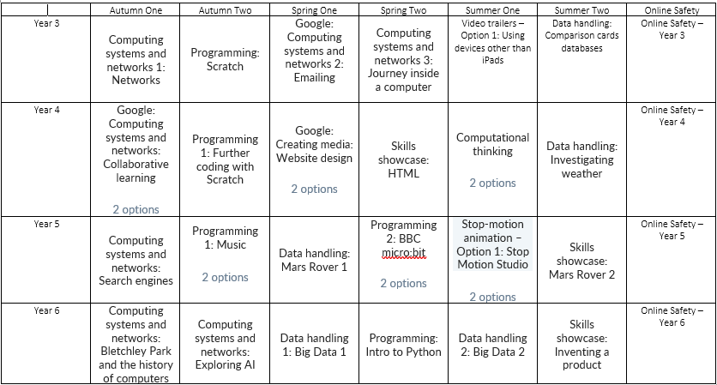
Overview

Slide 5
Intent
At Meadowhead Junior School, our intent for the Key Stage 2 Computing curriculum, based on the Kapow Primary scheme of work, is to equip pupils with the knowledge, skills and understanding they need to thrive in an increasingly digital world. We aim to develop confident, responsible and creative users of technology who can apply computational thinking and digital skills across the curriculum and into real-life contexts.
Through the Kapow scheme, our curriculum is carefully sequenced to build on prior learning from Key Stage 1, ensuring progression in the key strands of computer science, information technology and digital literacy. Pupils develop a strong foundation in coding and computational thinking, learning how to decompose problems, recognise patterns, design algorithms and debug programs using a range of age-appropriate software and devices.
We intend for pupils to become competent in using technology to create, organise, store, manipulate and present digital content, including text, images, data and multimedia. By engaging in purposeful and creative projects, pupils learn how digital tools can be used to communicate ideas effectively and solve problems.
A key element of our intent is to ensure that pupils understand how to use technology safely, respectfully and responsibly. Online safety and digital citizenship are woven throughout the Kapow curriculum, enabling pupils to develop an awareness of potential risks, understand how to keep themselves and others safe online, and make informed choices about their digital footprint.
Our KS2 Computing curriculum also aims to promote curiosity, resilience and independence, encouraging pupils to experiment, collaborate and persevere when faced with challenges. We strive to ensure that all pupils, regardless of background or ability, can access and succeed in computing, preparing them with essential skills for the next stage of education and for life in modern Britain.

Slide 6
Implementation
At Meadowhead Junior School, Computing is taught as a weekly discrete subject across Key Stage 2 using the Kapow Primary scheme of work, ensuring a consistent and progressive curriculum for all pupils in our two-form entry junior school. The curriculum is carefully sequenced to build on prior knowledge and experiences, with clear progression across the strands of computer science, information technology and digital literacy.
Lessons are delivered using Chromebooks and iPads, enabling pupils to develop practical, hands-on skills through a range of programming, data handling and creative digital tasks. Teachers use Kapow’s structured planning and subject knowledge guidance to ensure clarity of instruction, consistency between classes and high-quality learning experiences for all pupils.
Given our school context, inclusion is central to implementation. Lessons are adapted to meet the needs of pupils with high levels of SEND and disadvantage through careful scaffolding, visual supports, chunked instructions, adult support and opportunities for overlearning. Adaptive teaching ensures all pupils can access core learning, while providing challenge and extension where appropriate.
Oracy is embedded throughout computing lessons. Pupils are encouraged to explain their thinking, discuss algorithms, justify choices and use correct technical vocabulary through paired work, group discussions and class reflection. This supports both conceptual understanding and communication skills.
Enrichment opportunities are woven into the curriculum through creative projects, cross-curricular links and real-life applications of technology, helping pupils to see computing as purposeful and relevant. Online safety is taught explicitly and revisited regularly, ensuring pupils develop a secure understanding of how to use technology safely, respectfully and responsibly in and beyond school.
Ongoing formative assessment is used to identify misconceptions, inform teaching and support progression. Subject leadership ensures regular monitoring, staff support and curriculum refinement to meet the needs of our pupils.

Slide 7
Impact
As a result of the KS2 Computing curriculum at Meadowhead Junior School, pupils develop the knowledge, skills and confidence needed to engage successfully with technology, regardless of starting point. Pupils demonstrate clear progression in computational thinking, problem-solving and digital creativity, applying these skills with increasing independence over time.
Pupils are able to articulate their learning using appropriate technical vocabulary, reflecting the school’s focus on oracy. They can explain how programs work; describe the steps they have taken to solve problems and evaluate digital outcomes thoughtfully.
The inclusive approach ensures that pupils with SEND and those who are disadvantaged are well supported to access and succeed in computing. Gaps in knowledge and confidence are reduced through consistent teaching, repetition and targeted support, enabling pupils to achieve positive outcomes.
Pupils engage enthusiastically in computing lessons and enrichment opportunities, demonstrating resilience, curiosity and pride in their digital work. They show a strong understanding of online safety and digital responsibility, making informed choices when using technology.
By the end of Key Stage 2, pupils are well prepared for the next stage of their education. They leave Meadowhead Junior School as confident, responsible users of technology with transferable skills that support learning across the curriculum and equip them for life in an increasingly digital society.

Slide 8
Teaching and Learning
All learners regardless of their individual starting point will have access to the Computing curriculum and it is for each teacher to adapt their teaching to enable this.
To facilitate learning in Computing, it is considered good practice to ensure that:
The purpose of each lesson is made clear
Appropriate learning experiences are planned and meet the needs of all pupils in the class (see inclusion below and our SEND Policy) and draw upon own experiences or existing knowledge
Lessons provide a range of opportunities for pupils to learn, practice and demonstrate skills but also discuss and engage critically with material to deepen their knowledge and understanding
Time is given for pupils to reflect, consolidate and apply their learning in different contexts
Pupils are encouraged to take responsibility for their own learning and to reflect on their own progress
Attention is given to developing a safe and secure classroom climate
Staff training needs are met
Visitors and visits are provided to broaden children’s understanding.
At Meadowhead Juniors, we believe it is vital to have the latest technology available to support each child's learning. Within school, we have over 90 Chrome Books, 45 iPads, 10 interactive whiteboards and classroom PC. Extra curricular opportunities are available to further develop children's love for learning; they are proven to further enhance educational outcomes and enable children to flourish in a variety of curriculum areas. The school actively participates in the annual Safer Internet Day, and online safety is further embedded throughout the curriculum to ensure pupils develop the knowledge and skills needed to use technology safely, responsibly, and confidently.

Slide 9
Inclusion
Pre-teach and reinforce computing vocabulary (e.g. algorithm, debug, sequence, variable, input/output) using visual word mats and symbol-supported definitions before Kapow Computing lessons.
Break down programming tasks in Scratch and other coding units into small, manageable steps with checklists, worked examples and screenshots to support understanding and independence.
Use visual supports throughout Kapow Computing units, including Now/Next boards, colour-coded coding blocks, visual success criteria and modelled demonstrations for Computing Systems, Programming, Data Handling and Digital Media lessons.
Provide scaffolded versions of Kapow activities by using templates, partially completed projects, pre-filled spreadsheets and structured planning sheets to reduce cognitive demands while maintaining learning objectives.

Slide 10
Inclusion
Support communication and explanation of computing concepts through sentence stems such as "I debugged my program by..." or "The data shows..." rather than relying solely on written responses.
Adapt assessment opportunities within Kapow Computing by allowing pupils to demonstrate learning through practical demonstrations, verbal explanations, screen recordings or teacher discussion instead of extended written work.
Make abstract computing concepts more concrete by using physical resources and real-life examples, such as sorting hardware devices in Computing Systems units or using real objects before introducing data collection and spreadsheets.
Increase engagement and independence across all Kapow strands by offering structured choices, regular feedback, movement breaks, assistive technology and clear support prompts, enabling SEND pupils to access Programming, Data, Digital Media, Online Safety and Computing Systems learning more successfully.

Slide 11

OFSTED
On the 16th May 2022, Ofsted published a literature review with the aim of identifying the factors which contribute to a high-quality computing curriculum. The guidance covers all aspects of the computing curriculum, from early years to A-level.
For the full document, with the research and reasoning supporting these recommendations, click here
Summary:
The planned curriculum includes a breadth of knowledge relating to computer science, information technology and digital literacy.
Declarative knowledge – substantive (‘knowing that’) and procedural knowledge – disciplinary (‘knowing how’) are identified, sequenced and connected in the curriculum.
Skilful use of technology is underpinned by procedural and declarative knowledge

Slide 12
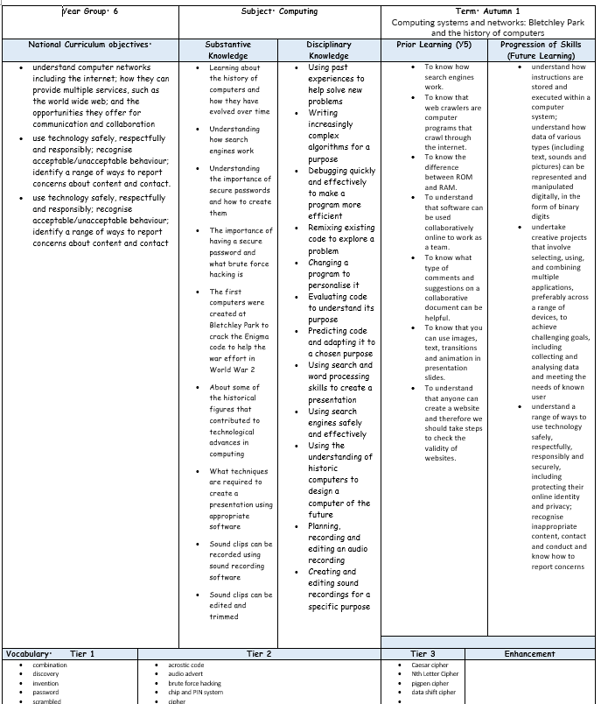
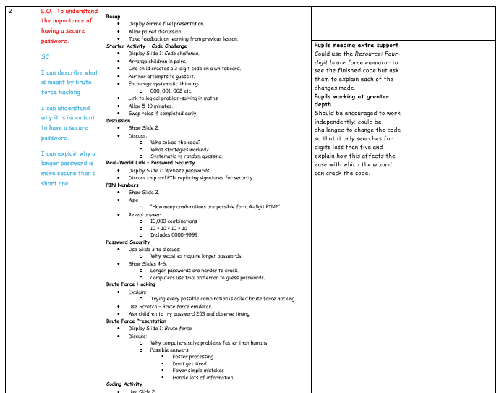
Planning
Planning follows the KAPOW scheme of work and is adapted for each class. NC links, substantive and disciplinary knowledge, prior and future learning are identified. Key vocabulary, outcomes and cross-curricular links are also identified.
Each lesson is broken down into easy-to-follow steps, adapted for the class needs with clear learning objectives, success criteria and key adaptation.

Slide 13
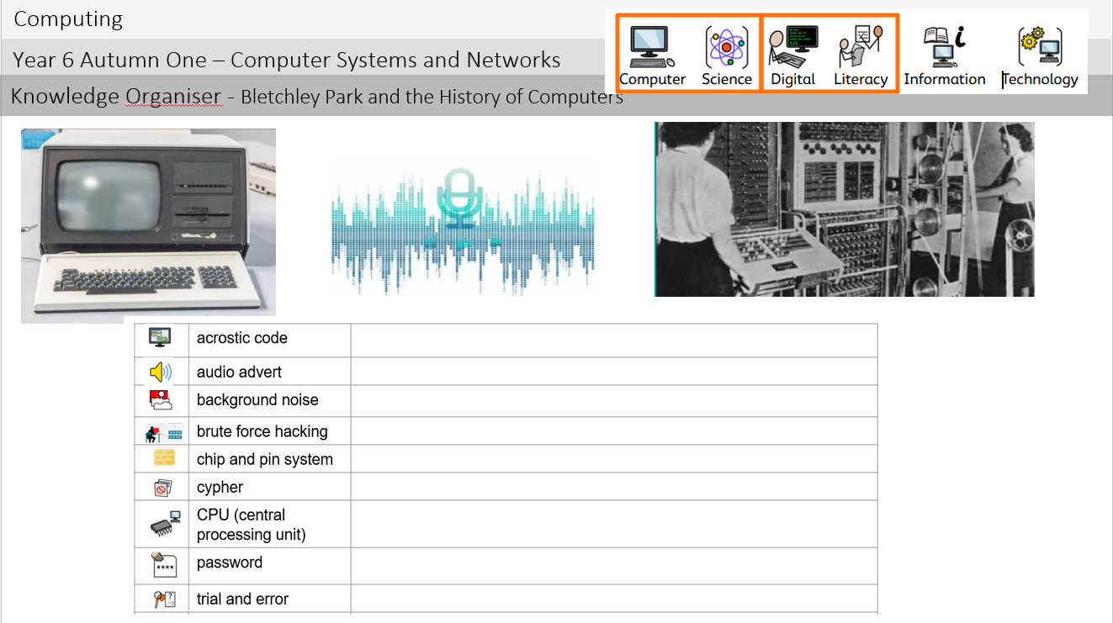
Planning
Knowledge organisers are used to support pupils in remembering and revisiting the key knowledge, vocabulary and concepts from a unit of work. They provide a clear and accessible summary of the most important learning, helping pupils to make connections between new and prior knowledge. Knowledge organisers also support retrieval practice, independent learning and home-school communication, ensuring that all pupils, including those with SEND, have a consistent reference point throughout their learning journey.
Key learning is noted around the knowledge organiser.

Slide 14
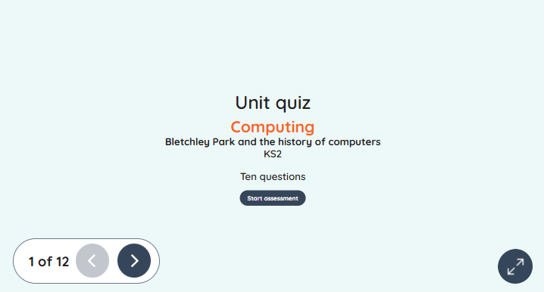
Assessment
Formative assessment in KS2 Computing is an ongoing process that helps teachers identify pupils’ understanding, misconceptions, and progress throughout a unit of work. By using questioning, observation, discussion, and practical tasks during lessons, teachers can gather evidence of learning and adapt teaching to meet pupils’ needs. The KAPOW Computing scheme supports formative assessment through its end-of-unit assessment quizzes, which provide a structured way to check pupils’ knowledge and understanding of key concepts. These quizzes enable teachers to evaluate how well learning objectives have been met, identify areas that may require further teaching or consolidation, and inform future planning. Combined with regular classroom assessment strategies, KAPOW’s quizzes help ensure that pupils make secure progress in computing while building confidence and competence across the curriculum.

Slide 15
Monitoring
Learning walks and lesson observations.
Pupil voice interviews and surveys.
Work scrutiny of digital and written outcomes.
Analysis of assessment data, including KAPOW assessment quizzes.
Review of curriculum coverage and progression.
Scrutiny of teacher planning.
Monitoring of online safety provision.
Staff voice and confidence surveys.
Moderation of pupil work across year groups.
Evaluation of technology and resource use.
Tracking pupil progress over time.
Reporting findings to governors and senior leaders.

Slide 16
Role of the Governor
The Computing Link Governor plays an important role in supporting and monitoring the quality of Computing education across KS2 at Meadowhead Juniors.
Working alongside the Computing Subject Leader, the governor gains an understanding of how the curriculum is implemented, the progress pupils are making, and how statutory requirements, including online safety, are being met. This may involve reviewing subject leader reports, discussing assessment information, visiting the school to meet pupils and staff, and monitoring the impact of curriculum developments.
The role is not to evaluate individual teachers, but to provide strategic oversight, offer support and challenge where appropriate, and report back to the governing board to ensure that Computing remains a high-quality and effective part of the curriculum.

Slide 17
Equal Opportunities
1. All pupils will have equal access to the entire computing curriculum
2. Gender, learning ability, physical ability, ethnicity, linguistic ability and/or cultural circumstances will not impede pupils from accessing all computing lessons.
3. Where it is inappropriate for a pupil to participate in a lesson because of reasons related to any of the factors outlined above, the lessons will be adapted to meet the pupil’s needs and alternative arrangements involving extra support, will be provided where necessary.
4. All efforts will be made to ensure that cultural and gender differences will be positively reflected in all lessons and teaching materials used.
5. Meadowhead Juniors aims to provide more academically able pupils with the opportunity to extend their thinking through extension activities such as providing further enquiry questions.

Slide 18
Evidence

Slide 19
Evidence

Slide 20
Evidence

