Slide 1

Design & Technology

Slide 2
Design & Technology Policy
Policy Title | Design & Technology Policy
Ratified by | Jason Newsham
Subject Leader | Zaynab Gharda
Date ratified
Review date
Named governor

Slide 3
Role of the Subject Leader
The KS2 Design & Technology Subject Leader is responsible for leading and developing the Design Technology curriculum across Key Stage 2, ensuring that it is engaging, progressive, and aligned with the National Curriculum. They support teachers with planning, resources, and professional development, while monitoring the quality of teaching and learning through activities such as lesson observations, work scrutiny, pupil voice, and assessment analysis. The subject leader also evaluates pupil progress, promotes the development of practical skills, creativity, problem-solving and independence, and ensures that pupils have opportunities to design, make, evaluate and improve a range of products using different materials, tools and techniques. They work with senior leaders to identify strengths and areas for improvement, ensuring that resources and health and safety procedures are appropriate. Through these responsibilities, they help ensure that all pupils develop the knowledge, skills, confidence and creativity needed to become capable and thoughtful designers and makers.

Slide 4
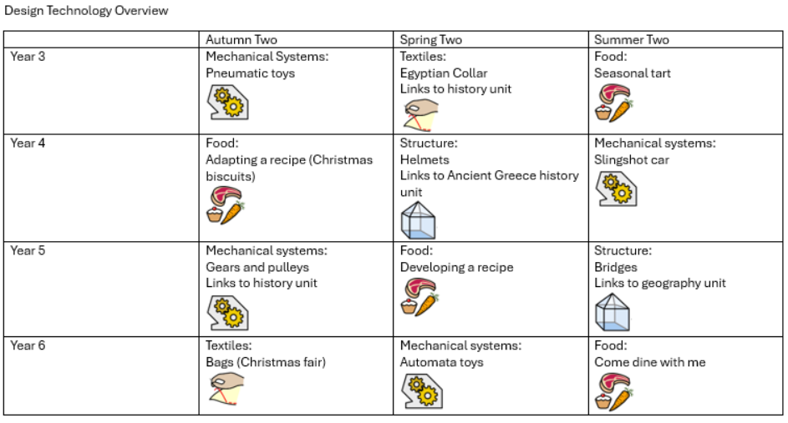
Overview

Slide 5
Intent
At Meadowhead Junior School, our Design and Technology curriculum develops children’s skills and knowledge in design, structures, mechanisms, electrical control and a range of materials, including food. It encourages children’s creativity and encourages them to think about important issues.
Learning new skills, problem-solving, being creative and enjoyment are at the heart of a child’s development. As outlined in the National Curriculum, Design and Technology is an inspiring, rigorous and practical subject. Using creativity and imagination, pupils design and make products that solve real and relevant problems within a variety of contexts, considering their own and others’ needs, wants and values.
The National Curriculum for Design and Technology aims to ensure that all pupils:
Develop the creative, technical and practical expertise needed to perform everyday tasks confidently and to participate successfully in an increasingly technological world.
Build and apply a repertoire of knowledge, understanding and skills in order to design and make high-quality prototypes and products for a wide range of users.
Critique, evaluate and test their ideas and products and the work of others.
Understand and apply the principles of nutrition and learn how to prepare simple healthy meals.
Build on their vocabulary and apply it accurately

Slide 6
Implementation
Our Key Stage Two Design and Technology curriculum is carefully tailored to the needs, interests and experiences of our children, providing them with practical, hands-on opportunities to develop creativity, problem-solving skills and technical understanding. Through a balanced focus on food technology, mechanical systems, structural design and textiles, pupils learn to design, make and evaluate purposeful products that reflect real-life contexts. Units are sequenced to build progressively on prior knowledge, ensuring that children develop increasing independence and confidence as they explore cooking and nutrition, create moving mechanisms, construct stable structures and work with a variety of fabrics and stitches. This bespoke approach ensures that all pupils can apply their learning in meaningful ways, developing the skills and resilience needed to take risks, innovate and produce high-quality outcomes.

Slide 7
Impact
At Meadowhead Junior School, our Design and Technology curriculum is designed to equip every child with the practical knowledge and transferable skills needed to thrive in an ever-changing world. By engaging in food technology, mechanical systems every year, and developing the life skills of textiles, sewing and structural development, pupils develop a deep understanding of how things are designed, made, and function in the real world. Learning about food teaches children how to make informed nutritional choices, prepares them for independent living and promotes lifelong habits that support health and wellbeing. Mechanical systems education fosters problem-solving, resilience and creative thinking as learners explore how movement, energy and control shape the products and technologies around them. The inclusion of textiles and structural development further builds fine motor skills, spatial awareness and an appreciation of sustainability through designing, repairing and re-using resources. Collectively, these subjects nurture confident, adaptable individuals who can apply technical knowledge and practical skills with purpose, creativity and responsibility. Through this curriculum, children leave our school empowered to contribute meaningfully to modern society as informed consumers, innovative designers and independent, capable young citizens.
By the time pupils leave Year 6, they have developed strong problem-solving abilities, confidence in using tools and materials, and a deep understanding of how design impacts the world around them. They are equipped with the knowledge of sustainability, the importance of healthy living and how technology can be used to improve everyday life.
The curriculum encourages pupils to think critically, work collaboratively, and take responsibility for their creations, ensuring they leave school with the skills to approach future challenges with confidence and creativity. Pupils not only gain practical skills but also learn how to apply their knowledge across subjects, making connections between design, science, and the real world.
Ultimately, our DT curriculum prepares pupils for life beyond school, equipping them with the creativity, resilience, and practical skills necessary to thrive in an ever-changing world.

Slide 8
Teaching and Learning
All learners regardless of their individual starting point will have access to the Design Technology curriculum and it is for each teacher to adapt their teaching to enable this.
To facilitate learning in Design Technology, it is considered good practice to ensure that:
The purpose of each lesson is made clear
Appropriate learning experiences are planned and meet the needs of all pupils in the class (see inclusion below and our SEND Policy) and draw upon own experiences or existing knowledge
Lessons provide a range of opportunities for pupils to learn, practice and demonstrate skills but also discuss and engage critically with material to deepen their knowledge and understanding
Time is given for pupils to reflect, consolidate and apply their learning in different contexts
Pupils are encouraged to take responsibility for their own learning and to reflect on their own progress
Attention is given to developing a safe and secure classroom climate
Staff training needs are met
Visitors and visits are provided to broaden children’s understanding.

Slide 9
Inclusion
Pre-teach and reinforce Design Technology vocabulary (e.g. design, prototype, evaluate, mechanism, structure, material, function, strength) using visual word mats, real-life examples and symbol-supported definitions before Kapow Design Technology lessons.
Break down designing and making tasks into small, manageable steps using checklists, visual instructions, worked examples and modelled demonstrations to support pupils with SEND in developing independence and confidence.
Use visual supports throughout Kapow Design Technology units, including Now/Next boards, visual success criteria, step-by-step photographs, labelled diagrams and teacher modelling for Structures, Mechanisms, Textiles and Food Technology lessons.
Provide scaffolded versions of Kapow activities by using design templates, partially completed plans, labelled diagrams, adapted tools and structured planning and evaluation sheets to reduce cognitive demands while maintaining the intended learning objectives.

Slide 10
Inclusion
Provide appropriate adaptations to tools and materials for pupils who experience difficulties with fine motor skills, coordination or sensory processing, including alternative grips, larger equipment, pre-cut materials and additional adult or peer support where appropriate.
Model practical skills explicitly through an 'I do, we do, you do' approach, demonstrating techniques such as cutting, joining, stitching, measuring, shaping and assembling before pupils attempt the skill independently.
Use repetition and opportunities to practise key skills across Kapow units so that pupils can revisit and consolidate techniques, vocabulary and knowledge before applying them independently in their own designs.
Support pupils to communicate and evaluate their ideas through sentence stems, visual choices, partner talk and structured evaluation prompts, enabling all pupils to explain their design decisions and identify ways to improve their products.

Slide 11
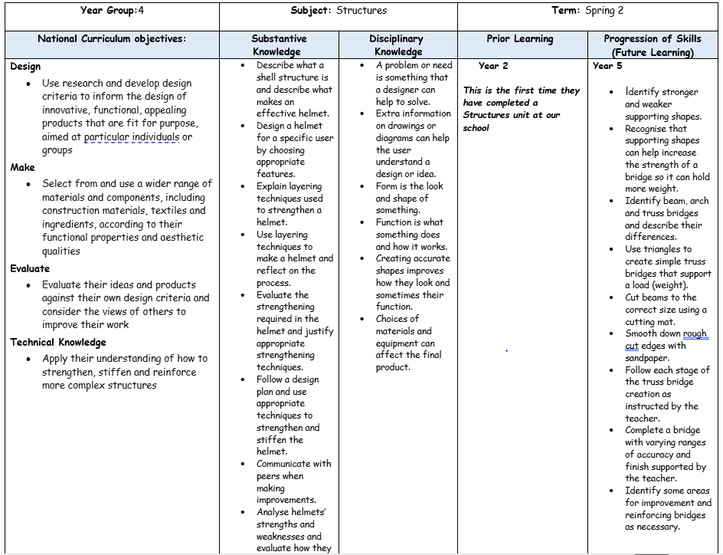
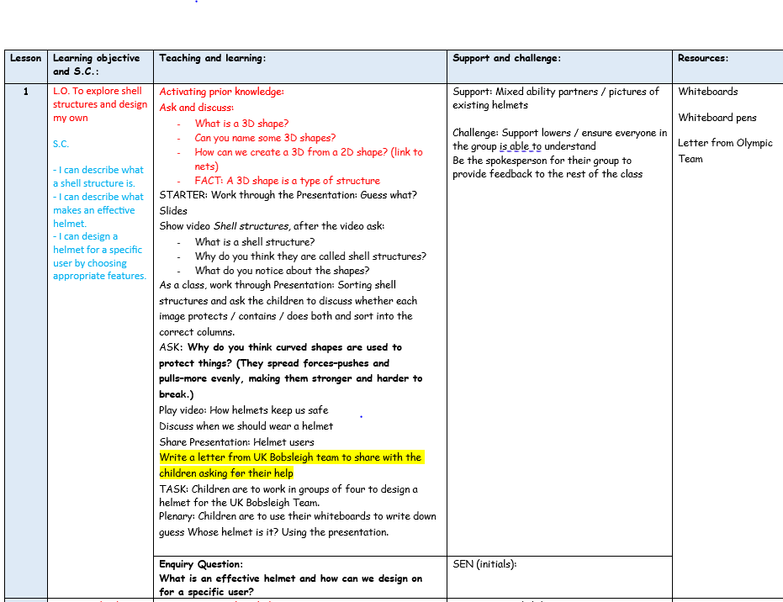
Planning
Planning follows the KAPOW scheme of work and is adapted for each class. NC links, substantive and disciplinary knowledge, prior and future learning are identified. Key vocabulary, outcomes and cross-curricular links are also identified.
Each lesson is broken down into easy-to-follow steps, adapted for the class needs with clear learning objectives, success criteria and key adaptation.

Slide 12
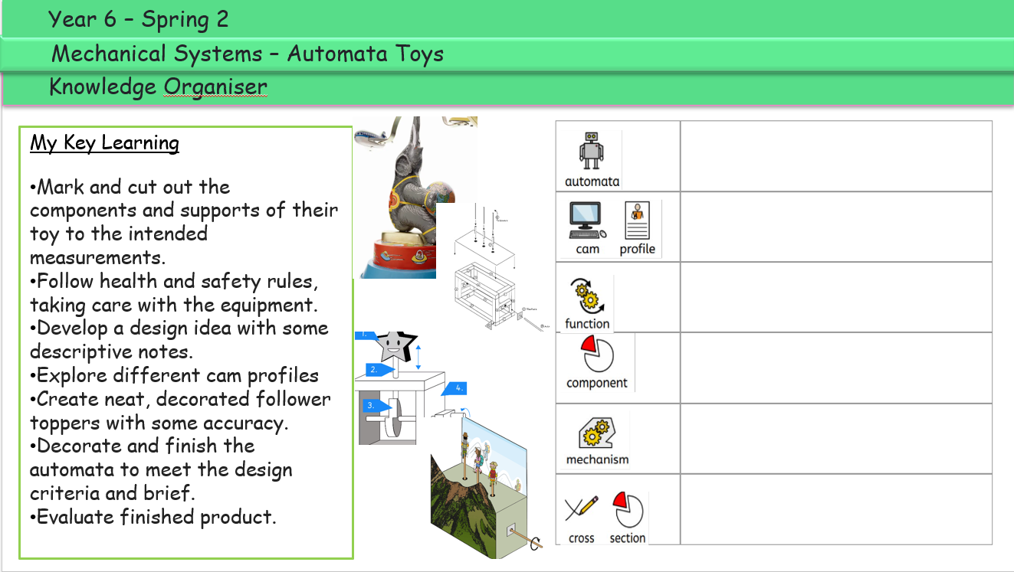
Planning
Knowledge organisers are used to support pupils in remembering and revisiting the key knowledge, vocabulary and concepts from a unit of work. They provide a clear and accessible summary of the most important learning, helping pupils to make connections between new and prior knowledge. Knowledge organisers also support retrieval practice, independent learning and home-school communication, ensuring that all pupils, including those with SEND, have a consistent reference point throughout their learning journey.
Key learning is noted around the knowledge organiser.

Slide 13
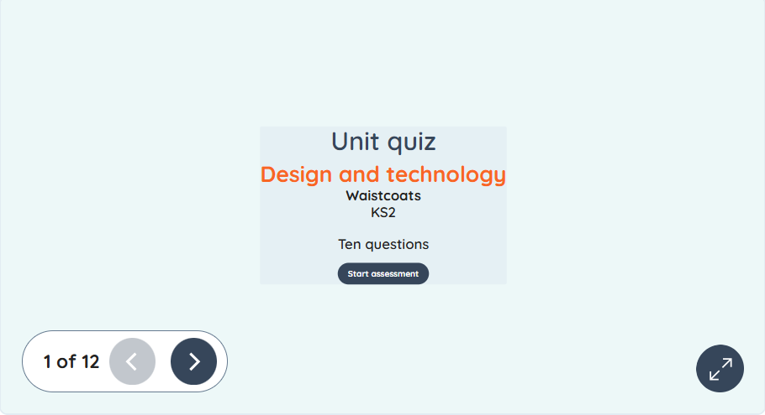
Assessment
Formative assessment in KS2 Design Technology is an ongoing process that helps teachers identify pupils’ understanding, misconceptions, and progress throughout a unit of work. By using questioning, observation, discussion, practical tasks, and evaluation of pupils’ designs and products, teachers can gather evidence of learning and adapt teaching to meet pupils’ needs. The KAPOW Design Technology scheme supports formative assessment through its end-of-unit assessment quizzes, which provide a structured way to check pupils’ knowledge and understanding of key concepts, vocabulary, materials, tools, and processes. These quizzes enable teachers to evaluate how well learning objectives have been met, identify areas that may require further teaching or consolidation, and inform future planning. Combined with regular classroom assessment strategies, KAPOW’s quizzes help ensure that pupils make secure progress in Design Technology while developing confidence and competence in designing, making, evaluating, and improving products.

Slide 14
Monitoring
• Learning walks and lesson observations.
• Pupil voice interviews and surveys.
• Work scrutiny of design plans, practical outcomes and evaluations.
• Analysis of assessment data, including KAPOW assessment quizzes.
• Review of curriculum coverage and progression of knowledge and skills.
• Scrutiny of teacher planning.
• Monitoring of designing, making, evaluating and technical knowledge.
• Staff voice and confidence surveys.
• Moderation of pupil work and practical outcomes across year groups.
• Evaluation of tools, materials, equipment and resource use.
• Tracking pupil progress and development of practical skills over time.
• Monitoring of SEND adaptations and accessibility within practical activities.
• Reporting findings to governors and senior leaders.

Slide 15
Role of the Governor
The curriculum governor and education committee work with the Design and Technology Subject Leader to provide appropriate oversight and support for the subject across the school. They develop an understanding of the Design and Technology curriculum, including its progression of knowledge and practical skills, and monitor how effectively the subject is being implemented. The link governor meets with the subject leader to discuss curriculum developments, strengths, areas for improvement, pupil progress, inclusion, resources and subject priorities. They may support the monitoring of Design and Technology through activities such as learning walks, reviewing curriculum documentation, discussing pupil voice and looking at examples of pupils' work.
The link governor also provides an opportunity for the subject leader to share the impact of developments and any challenges or resource needs. Through regular communication and appropriate challenge, the link governor helps governors maintain an informed understanding of the quality and impact of Design and Technology across the school.

Slide 16
Equal Opportunities
1. All pupils will have equal access to the entire Design and Technology curriculum
2. Gender, learning ability, physical ability, ethnicity, linguistic ability and/or cultural circumstances will not impede pupils from accessing all Design and Technology lessons.
3. Where it is inappropriate for a pupil to participate in a lesson because of reasons related to any of the factors outlined above, the lessons will be adapted to meet the pupil’s needs and alternative arrangements involving extra support, will be provided where necessary.
4. All efforts will be made to ensure that cultural and gender differences will be positively reflected in all lessons and teaching materials used.
5. Meadowhead Juniors aims to provide more academically able pupils with the opportunity to extend their thinking through extension activities such as providing further enquiry questions.

Slide 17
Evidence

Slide 18
Evidence

Slide 19
Evidence

