Slide 1

Art and Design

Slide 2
Art and Design Policy
Policy Title | Art and Design Policy
Ratified by | Jason Newsham
Subject Leader | Hannah Barnes
Date ratified
Review date
Named governor

Slide 3
Role of the Subject Leader
The KS2 Art and Design Subject Leader is responsible for leading and developing the Art and Design curriculum across Key Stage 2, ensuring that it is engaging, progressive, and aligned with the National Curriculum. They support teachers with planning, resources, and professional development, while monitoring the quality of teaching and learning through activities such as learning walks, work scrutiny, pupil voice, and assessment analysis. The subject leader also evaluates pupil progress, promotes the development of artistic knowledge, creativity, skills and vocabulary, and ensures that pupils have opportunities to explore a range of artists, cultures, media and techniques. They work with senior leaders to identify strengths and areas for improvement, ensuring that pupils have opportunities to experiment, develop ideas, refine techniques and evaluate their artwork. Through these responsibilities, they help ensure that all pupils develop the knowledge, skills, confidence and creativity needed to express themselves and appreciate art and design.

Slide 4
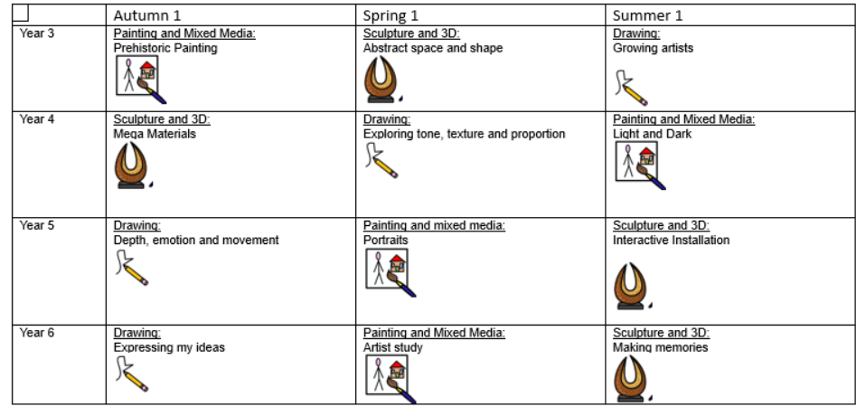
Overview

Slide 5
Intent
At Meadowhead Juniors, our KS2 art curriculum aims to inspire, challenge and empower pupils to express themselves creatively while developing a secure understanding of key artistic concepts and techniques. Through the Kapow Primary scheme of work, we ensure that drawing, painting and sculpture are taught progressively and coherently so that pupils:
Build confidence in their artistic abilities and develop a sense of personal expression.
Acquire and refine a broad range of practical skills across the key art disciplines.
Understand how artists, craft makers and designers across cultures and time periods influence artistic styles, processes and meanings.
Learn to think critically, evaluate their own work and appreciate the creative achievements of others.
Develop resilience, curiosity and a willingness to experiment through a structured yet creative curriculum.

Slide 6
Intent
National Curriculum Context
Our curriculum aligns fully with the KS2 National Curriculum for Art and Design, which requires pupils to develop their techniques and improve their mastery of art and design through drawing, painting and sculpture. Pupils are expected to use sketchbooks effectively to record observations, explore ideas and revisit and refine their work. They also learn about great artists, architects and designers in history, building cultural understanding and artistic appreciation. Kapow’s progressive structure ensures pupils meet and exceed these statutory requirements by providing rich opportunities to experiment with materials, study influential artists and create purposeful, original artwork.
The overarching intent is to nurture pupils’ creativity, support their wellbeing, and equip them with transferable skills in observation, problem-solving and communication.

Slide 7
Implementation
Our curriculum is implemented through the Kapow Primary scheme, which provides a clear, progressive structure for the teaching of drawing, painting and sculpture in KS2. Teachers deliver art lessons weekly, with units designed to build on prior KS1 learning and deepen understanding over time.
Drawing
Pupils explore line, tone, texture, proportion and perspective using a variety of media such as graphite, charcoal, ink and pastels.
Sketchbooks are used consistently to practise techniques, experiment with ideas and evaluate progress.
Units introduce pupils to a range of illustrators and artists to provide inspiration and context.
Painting
Teaching develops pupils’ understanding of colour theory, colour mixing, brush control and composition through the use of watercolours, acrylics and mixed media.
Guided activities help pupils refine key techniques, while open-ended tasks enable them to make creative choices and develop their own visual style.
Pupils study artworks from different cultures and eras, analysing how colour, shape and form convey mood and meaning.
Sculpture
Pupils work with materials such as clay, wire, modroc, card and found objects to create three-dimensional forms.
They learn and apply techniques including modelling, carving, joining and constructing armatures.
Projects often connect with wider curriculum themes, strengthening cross-curricular understanding and creativity.
Across all disciplines:
Key vocabulary and artistic terminology are taught explicitly and revisited to secure understanding.
Assessment is ongoing through sketchbook evidence, teacher observation, peer discussion and final outcomes.
Kapow’s structured lesson guidance, high-quality resources and video modelling support teacher confidence and ensure consistency across classes.

Slide 8
Impact
By the end of KS2, pupils will:
Demonstrate confidence and increasing proficiency in drawing, painting and sculptural techniques.
Produce artwork that shows clear progression, from initial explorations to refined outcomes, using sketchbooks effectively throughout the process.
Use artistic vocabulary with accuracy to describe techniques, processes and the work of artists.
Show an ability to experiment, take creative risks and evaluate their own and others’ work thoughtfully and constructively.
Understand the significance of art within different cultures, historical periods and contemporary contexts.
Leave KS2 well-prepared for the challenges of the KS3 art curriculum, with secure foundational skills, cultural awareness and a positive attitude towards artistic learning.
The impact of the curriculum is monitored through pupil voice, sketchbook scrutiny, lesson observations and displays of work. Evidence shows that pupils develop both technical skill and creative confidence, and that art supports their wellbeing, enjoyment and cultural understanding.

Slide 9
Teaching and Learning
All learners, regardless of their individual starting point, will have access to the KS2 Art and Design curriculum and it is for each teacher to adapt their teaching to enable this.
To facilitate learning in Art and Design, it is considered good practice to ensure that:
• The purpose of each lesson is made clear and pupils understand the artistic knowledge or skill they are developing.
• Appropriate learning experiences are planned and meet the needs of all pupils in the class (see inclusion below and our SEND Policy), building upon pupils' existing knowledge, skills and experiences.
• Lessons provide a range of opportunities for pupils to explore, practise and demonstrate artistic skills, as well as discuss and respond to the work of artists, designers and craftspeople to deepen their knowledge and understanding.
• Pupils are given opportunities to experiment with a range of materials, media, techniques and processes, including drawing, painting, sculpture, craft and design.
• Time is given for pupils to reflect, consolidate and apply their learning by developing ideas, refining techniques and evaluating their own and others' artwork.
• Pupils are encouraged to take responsibility for their own creative learning and to reflect on their artistic choices, skills and progress.
• Attention is given to developing a safe, supportive and inclusive classroom climate where pupils feel confident to experiment, make creative choices, take risks and share their ideas.
• Staff training needs are identified and met to develop confidence and subject knowledge in Art and Design, including the effective use of materials, tools and techniques.
• Artists, designers and craftspeople are explored through the Kapow curriculum, with visitors, workshops and visits provided where appropriate to broaden pupils' understanding, experiences and appreciation of Art and Design.

Slide 10
Inclusion
Our KS2 Art and Design curriculum, delivered through the Kapow scheme, is designed to ensure that all pupils can participate, achieve and develop confidence as artists. The curriculum provides a range of creative and practical experiences, with opportunities for pupils to develop and apply knowledge, skills and vocabulary through drawing, painting, sculpture, craft, design and other artistic processes.
Teachers use appropriate scaffolds, modelling, visual prompts, worked examples and practical demonstrations to support pupils with SEND, disadvantaged pupils and those requiring additional support. Tasks and outcomes can be adapted through the use of accessible materials, alternative tools, simplified instructions, additional adult support, peer collaboration and carefully structured steps, while maintaining high expectations and the intended learning objective. Kapow's progressive units allow teachers to revisit and reinforce key knowledge and skills, supporting pupils who may need additional opportunities to practise and consolidate their learning.

Slide 11
Inclusion
Particular consideration is given to pupils who may experience difficulties with fine motor skills, coordination, sensory processing, communication or concentration. Teachers provide appropriate adaptations to tools, materials and processes so that pupils can engage meaningfully with creative activities and develop increasing independence.
Art and Design also provides valuable opportunities for oracy, creativity, reflection and self-expression. Pupils are encouraged to discuss their ideas, respond to the work of artists, make creative choices, evaluate their work and respond to feedback. Through an inclusive and supportive approach, all pupils are enabled to experience success, develop artistic skills and understand that their ideas and creative responses are valued.

Slide 12

OFSTED
On the 22nd February 2023, Ofsted published a literature review with the aim of identifying the factors which contribute to a high-quality art and design curriculum. The guidance covers all aspects of the art and desigh curriculum, from early years to A-level.
For the full document, with the research and reasoning supporting these recommendations, click here
Summary:
Pupils can develop practical knowledge of how to create art, craft and design, for example by learning the methods and techniques that artists, craft-makers and designers use.
They can also build theoretical knowledge of the tools, materials and history of art, craft and design.
In addition, pupils can acquire disciplinary knowledge of the concept of art itself, such as the ways it is judged, valued and evaluated.
Pupils make progress in the art curriculum when they build practical, theoretical and disciplinary knowledge and learn the connections between them. A high-quality art and design curriculum sequences the knowledge that pupils learn. This helps pupils to get better as they move through early years, primary and secondary education.

Slide 13
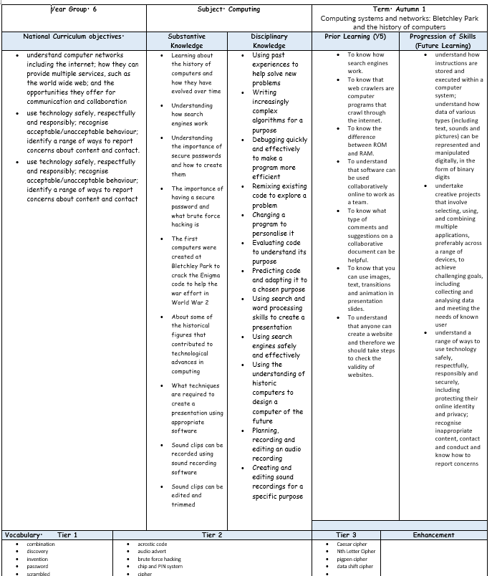
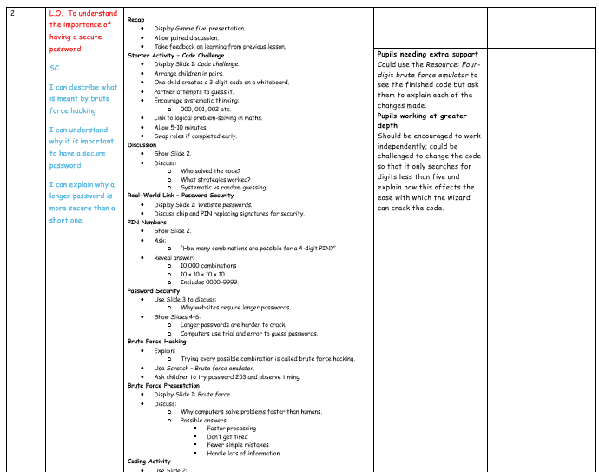
Planning
Planning follows the KAPOW scheme of work and is adapted for each class. NC links, substantive and disciplinary knowledge, prior and future learning are identified. Key vocabulary, outcomes and cross-curricular links are also identified.
Each lesson is broken down into easy-to-follow steps, adapted for the class needs with clear learning objectives, success criteria and key adaptation.

Slide 14
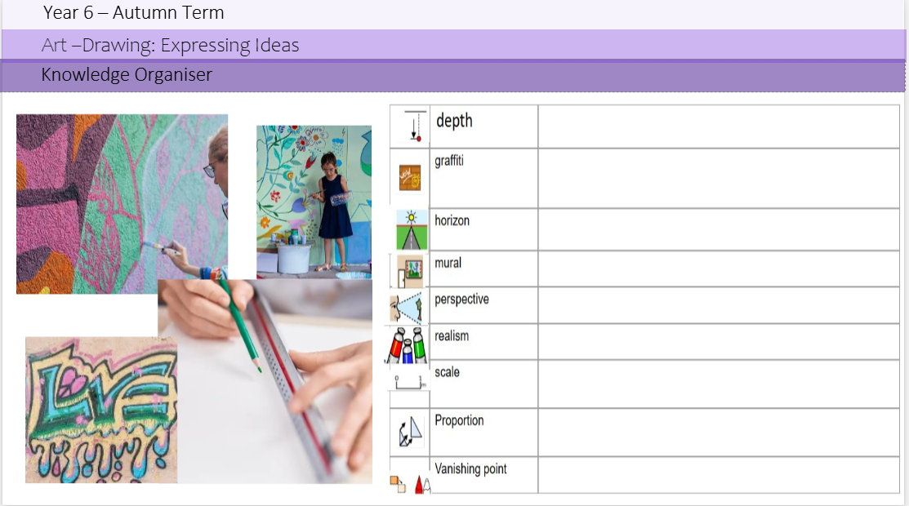
Planning
Knowledge organisers are used to support pupils in remembering and revisiting the key knowledge, vocabulary and concepts from a unit of work. They provide a clear and accessible summary of the most important learning, helping pupils to make connections between new and prior knowledge. Knowledge organisers also support retrieval practice, independent learning and home-school communication, ensuring that all pupils, including those with SEND, have a consistent reference point throughout their learning journey.
Key learning is noted around the knowledge organiser.

Slide 15
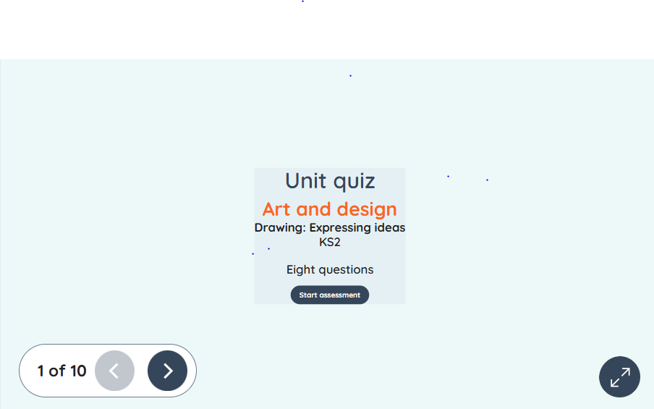
Assessment
Formative assessment in KS2 Art and Design is an ongoing process that helps teachers identify pupils’ understanding, misconceptions, and progress throughout a unit of work. By using questioning, observation, discussion, practical tasks, and evaluation of pupils' artwork, teachers can gather evidence of learning and adapt teaching to meet pupils’ needs. The Kapow Art and Design scheme supports formative assessment through its end-of-unit assessment quizzes, which provide a structured way to check pupils’ knowledge and understanding of key concepts, vocabulary, artists, techniques and processes. These quizzes enable teachers to evaluate how well learning objectives have been met, identify areas that may require further teaching or consolidation, and inform future planning. Combined with regular classroom assessment strategies, Kapow's quizzes help ensure that pupils make secure progress in Art and Design while developing confidence and competence in drawing, painting, sculpture, craft, design and other artistic techniques.

Slide 16
Monitoring
Learning walks and lesson observations.
• Pupil voice interviews and surveys.
• Work scrutiny of sketchbooks, artwork and creative outcomes.
• Analysis of assessment data, including Kapow assessment quizzes.
• Review of curriculum coverage and progression of artistic knowledge and skills.
• Scrutiny of teacher planning.
• Monitoring of drawing, painting, sculpture, craft, design and artistic techniques.
• Staff voice and confidence surveys.
• Moderation of pupil work across year groups.
• Evaluation of art materials, equipment and resource use.
• Tracking pupil progress and development of artistic skills over time.
• Monitoring of SEND adaptations and accessibility within creative activities.
• Reporting findings to governors and senior leaders.

Slide 17
Role of the Governor
The curriculum governor and education committee works with the Art and Design Subject Leader to provide appropriate oversight and support for the subject across the school. They develop an understanding of the Art and Design curriculum, including its progression of knowledge, skills and vocabulary, and monitor how effectively the subject is being implemented. The link governor meets with the subject leader to discuss curriculum developments, strengths, areas for improvement, pupil progress, inclusion, resources and subject priorities. They may support the monitoring of Art and Design through activities such as learning walks, reviewing curriculum documentation, discussing pupil voice and looking at examples of pupils' artwork and sketchbooks. The link governor also provides an opportunity for the subject leader to share the impact of developments and any challenges or resource needs. Through regular communication and appropriate challenge, the link governor helps governors maintain an informed understanding of the quality and impact of Art and Design across the school.

Slide 18
Equal Opportunities
1. All pupils will have equal access to the entire art and design curriculum
2. Gender, learning ability, physical ability, ethnicity, linguistic ability and/or cultural circumstances will not impede pupils from accessing all art and design lessons.
3. Where it is inappropriate for a pupil to participate in a lesson because of reasons related to any of the factors outlined above, the lessons will be adapted to meet the pupil’s needs and alternative arrangements involving extra support, will be provided where necessary.
4. All efforts will be made to ensure that cultural and gender differences will be positively reflected in all lessons and teaching materials used.
5. Meadowhead Juniors aims to provide more academically able pupils with the opportunity to extend their thinking through extension activities such as providing further enquiry questions.

Slide 19
Evidence

Slide 20
Evidence

Slide 21
Evidence

