Slide 1

MFL – French

Slide 2
MFL Policy
Policy Title | Computing Policy
Ratified by | Jason Newsham
Subject Leader | Helen Lawton
Date ratified
Review date
Named governor

Slide 3
Role of the Subject Leader
The KS2 MFL (Modern Foreign Languages) Subject Leader is responsible for leading and developing the languages curriculum across Key Stage 2, ensuring it is progressive, engaging, and meets the requirements of the National Curriculum.
They support staff with planning, resources, and subject knowledge, while monitoring the quality of teaching and learning through activities such as lesson observations, work scrutiny, pupil voice, and assessment reviews. The subject leader evaluates pupil progress, promotes cultural awareness and language learning opportunities, and identifies areas for curriculum development.
Working closely with senior leaders, they ensure that all pupils develop confidence in speaking, listening, reading, and writing in the target language, fostering a positive attitude towards language learning and global citizenship.

Slide 4
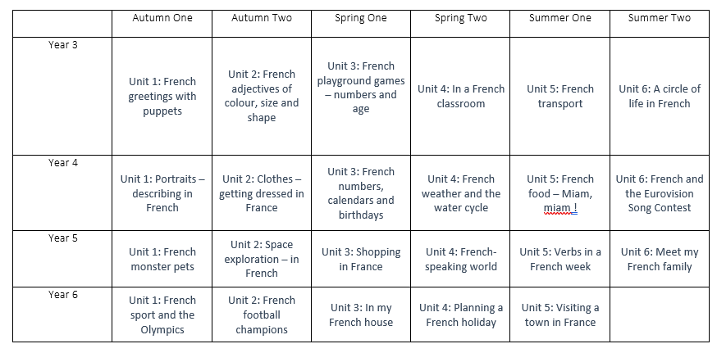
Overview

Slide 5
Intent
At Meadowhead Juniors, we believe that learning a modern foreign language provides an opening to other cultures and fosters curiosity, confidence and respect for the wider world. Through the teaching of French at Key Stage Two, we aim to:
Develop pupils’ confidence in listening, speaking, reading and writing in French.
Build a secure foundation of phonics, vocabulary and basic grammar.
Foster positive attitudes towards language learning and cultural diversity.
Equip pupils with the skills and knowledge needed for successful transition to Key Stage 3.
Our curriculum is underpinned by the Kapow Primary French Scheme of Work, which is fully aligned with the National Curriculum. The scheme ensures progression across Key Stage Two by building knowledge systematically year-on-year and revisiting key vocabulary and structures to support long-term retention.
We intend for pupils to:
Understand and respond to spoken and written language.
Speak with increasing confidence, fluency and spontaneity.
Write phrases and simple sentences using familiar vocabulary.
Develop an understanding of basic grammar (e.g., gender, articles, simple verb forms).
Gain insight into French culture and traditions.

Slide 6
Implementation
French is taught weekly across Key Stage Two using the structured progression provided by the Kapow scheme. Lessons are carefully sequenced to ensure pupils build on prior knowledge and develop skills progressively from Year 3 to Year 6.
Teaching Approach
Through Kapow, lessons include:
Clear progression in phonics to support accurate pronunciation.
Explicit teaching of vocabulary and grammar in meaningful contexts.
Opportunities for speaking and listening through songs, games, role-play and partner work.
Reading and writing activities that reinforce vocabulary and sentence construction.
Retrieval practice to support long-term memory.
Cultural learning embedded within units.
Curriculum Progression
Lower KS2 (Years 3 & 4):
Pupils develop confidence in speaking and listening. They learn key vocabulary linked to familiar topics (e.g., greetings, numbers, colours, family) and begin constructing simple phrases.
Upper KS2 (Years 5 & 6):
Pupils extend sentences using conjunctions, begin to manipulate language, and develop a deeper understanding of grammar. They engage in short conversations and produce simple written paragraphs.
Assessment for learning is ongoing within lessons through questioning, partner talk, and informal checks. End-of-unit assessments from Kapow support teacher judgement and ensure progression.

Slide 7
Impact
The impact of our French curriculum is evident in pupils who:
Demonstrate enthusiasm and curiosity about language learning.
Speak French with improving pronunciation and confidence.
Read and understand simple texts using taught vocabulary.
Write short phrases and sentences independently.
Apply basic grammatical structures accurately.
Show awareness and appreciation of French culture.
By the end of KS2, pupils leave with:
A secure foundation in French vocabulary and grammar.
The confidence to communicate in simple spoken and written forms.
The resilience and curiosity needed to continue language learning at KS3.
Through consistent use of the Kapow scheme, we ensure high-quality, progressive teaching that supports all learners in developing essential language skills and cultural understanding.

Slide 8
Teaching and Learning
All learners regardless of their individual starting point will have access to the MFL curriculum and it is for each teacher to adapt their teaching to enable this.
To facilitate learning in MFL, it is considered good practice to ensure that:
The purpose of each lesson is made clear
Appropriate learning experiences are planned and meet the needs of all pupils in the class (see inclusion below and our SEND Policy) and draw upon own experiences or existing knowledge
Lessons provide a range of opportunities for pupils to learn, practice and demonstrate skills but also discuss and engage critically with material to deepen their knowledge and understanding
Time is given for pupils to reflect, consolidate and apply their learning in different contexts
Pupils are encouraged to take responsibility for their own learning and to reflect on their own progress
Attention is given to developing a safe and secure classroom climate
Staff training needs are met
Visitors and visits are provided to broaden children’s understanding.

Slide 9
Inclusion
Support French vocabulary teaching with strong visual aids, including dual-coded word mats, picture cards, real objects and colour-coded categories to make new language accessible and memorable.
Adapt listening and speaking activities by reducing language load, using short chunks of French, frequent repetition, and allowing responses through single words, gestures or supported choices.
Embed multisensory learning strategies in French lessons, such as songs, actions (TPR), rhythm and movement to reinforce pronunciation and recall of key vocabulary and phrases.
Provide structured speaking scaffolds, including sentence stems (e.g. Je m’appelle…), choral repetition, and paired rehearsal before independent speaking.

Slide 10
Inclusion
Simplify listening tasks through pre-teaching and visual support, using vocabulary previews, pause/replay of audio, and visual answer grids instead of written responses.
Adapt reading and comprehension activities by reducing text length, highlighting key words, matching words to images, and minimising extended written demands.
Offer flexible ways to record learning in French, allowing pupils to demonstrate understanding through speaking, matching, pointing, acting or digital tools rather than written French.
Strengthen recall and engagement in French lessons through regular retrieval games, spaced repetition of core vocabulary, structured routines and fast-paced, short activities with clear expectations.

Slide 11

OFSTED
On the 7th June 2021, Ofsted published a research review with the aim of identifying the factors which contribute to creating a high-quality languages curriculum. The review draws on literature relating to language teaching, as well as inspection data from primary and secondary schools in England. The guidance investigates all possible areas of the curriculum, from early years to A-level. For the full document, click here
Summary:
Curriculum plans show clear logic behind progression in phonics, including around when to teach differences between English sound–spelling correspondences and those of the target language.
Planned practice and review of phonemes and how these link to graphemes is in place.
Curriculum plans show how small differences in sound can unlock meaning for pupils.

Slide 12
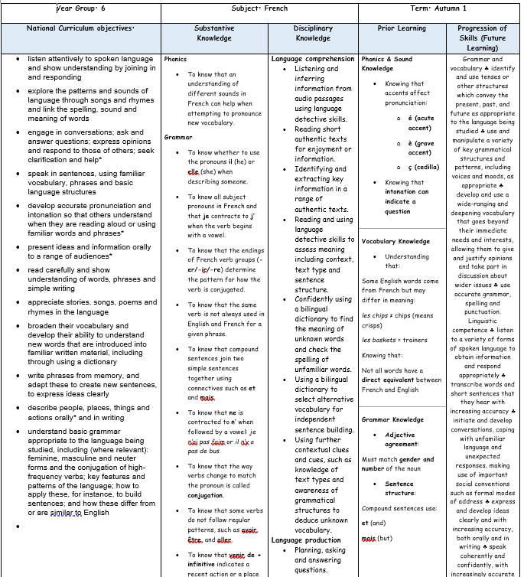
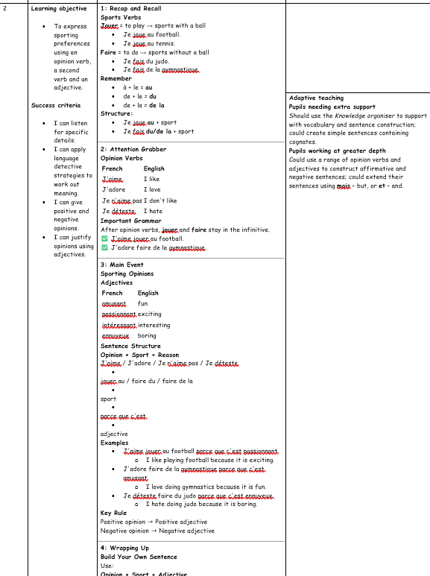
Planning
Planning follows the KAPOW scheme of work and is adapted for each class. NC links, substantive and disciplinary knowledge, prior and future learning are identified. Key vocabulary, outcomes and cross-curricular links are also identified.
Each lesson is broken down into easy-to-follow steps, adapted for the class needs with clear learning objectives, success criteria and key adaptation.

Slide 13
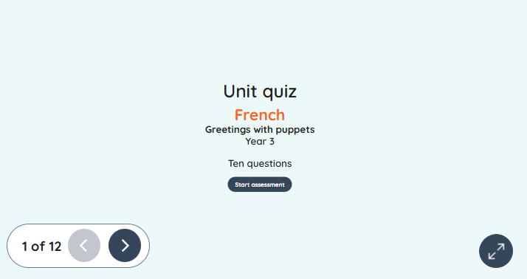
Assessment
Formative assessment in KS2 MFL is an ongoing process that enables teachers to monitor pupils’ developing knowledge and confidence in listening, speaking, reading, and writing in the target language. Through regular questioning, observation, repetition, games, and short retrieval activities, teachers can identify misconceptions and adapt teaching to support progress. The KAPOW MFL scheme supports this process through its end-of-unit assessment quizzes, which provide a structured way to check pupils’ understanding of key vocabulary, grammar, and language structures. These quizzes help teachers to evaluate how effectively pupils are meeting learning objectives and to identify areas that require further practice or reinforcement. When used alongside day-to-day formative assessment strategies, KAPOW’s quizzes ensure that assessment is accurate, consistent, and informs future planning, helping pupils to build secure foundations in language learning.

Slide 14
Monitoring
Learning walks and lesson observations.
Pupil voice interviews and surveys.
Work scrutiny.
Analysis of assessment data, including KAPOW assessment quizzes.
Review of curriculum coverage and progression.
Scrutiny of teacher planning.
Staff voice and confidence surveys.
Moderation of pupil work across year groups.
Evaluation of technology and resource use.
Tracking pupil progress over time.
Reporting findings to governors and senior leaders.

Slide 15
Role of the Governor
The curriculum governor and education committee play an important role in supporting and monitoring the quality of MFL education across KS2 at Meadowhead Juniors.
Working alongside the MFL Subject Leader, the governor gains an understanding of how the curriculum is implemented, the progress pupils are making, and how statutory requirements are being met. This may involve reviewing subject leader reports, discussing assessment information, visiting the school to meet pupils and staff, and monitoring the impact of curriculum developments.
The role is not to evaluate individual teachers, but to provide strategic oversight, offer support and challenge where appropriate, and report back to the governing board to ensure that MFL remains a high-quality and effective part of the curriculum.

Slide 16
Equal Opportunities
1. All pupils will have equal access to the entire MFL curriculum
2. Gender, learning ability, physical ability, ethnicity, linguistic ability and/or cultural circumstances will not impede pupils from accessing all MFL lessons.
3. Where it is inappropriate for a pupil to participate in a lesson because of reasons related to any of the factors outlined above, the lessons will be adapted to meet the pupil’s needs and alternative arrangements involving extra support, will be provided where necessary.
4. All efforts will be made to ensure that cultural and gender differences will be positively reflected in all lessons and teaching materials used.
5. Meadowhead Juniors aims to provide more academically able pupils with the opportunity to extend their thinking through extension activities such as providing further enquiry questions.

Slide 17
Evidence

Slide 18
Evidence

Slide 19
Evidence

