Slide 1

Music

Slide 2
Music Policy
Policy Title | Computing Policy
Ratified by | Jason Newsham
Subject Leader | Helen Lawton
Date ratified
Review date
Named governor

Slide 3
Role of the Subject Leader
The KS2 Music Subject Leader is responsible for leading and developing the music curriculum across Key Stage 2, ensuring it is engaging, progressive, and aligned with the National Curriculum.
They support staff with planning, subject knowledge, and access to resources, while monitoring the quality of teaching and learning through activities such as lesson observations, work scrutiny, pupil voice, and assessment analysis. The subject leader evaluates pupil progress in areas such as performance, composition, and listening, and ensures that assessment information, including any scheme-based tools such as KAPOW quizzes, is used effectively to inform planning and improve outcomes.
They also promote opportunities for musical enrichment, such as singing assemblies, performances, and extra-curricular activities, helping to foster a love of music and develop pupils’ confidence and creativity.

Slide 4
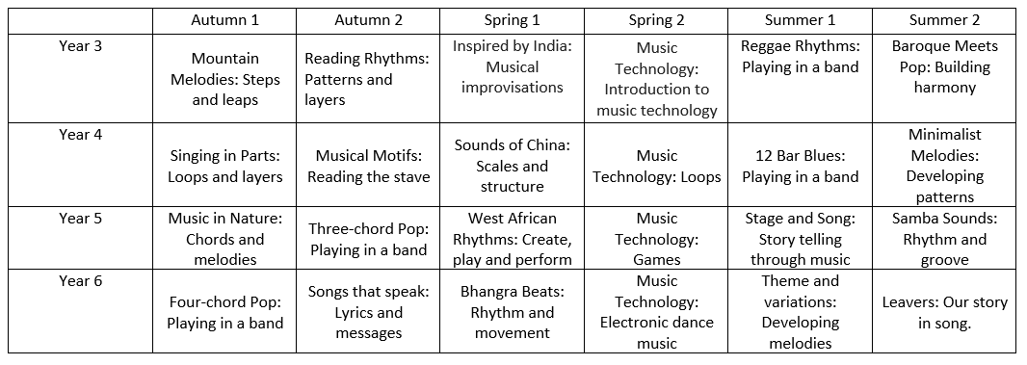
Overview

Slide 5
Overview – Transition Unit
T:\CURRICULUM 2025 Onwards\Music\transition to kapow units.pdf
To ensure a smooth and successful transition from the Junior Jam scheme of work to the Kapow Primary curriculum, we will implement the designated catch-up units during the first year of teaching.
These carefully selected units are designed to bridge any gaps in knowledge, vocabulary and skills while aligning pupils’ prior musical experiences with the progression and expectations of the new scheme. By revisiting and consolidating key concepts in an engaging and supportive way, children will be able to make meaningful connections between previous learning and new musical experiences, ensuring continuity, confidence and a seamless progression in their musical development.

Slide 6
Intent
At Meadowhead Junior School, we believe that music is a universal language and a powerful form of expression that can inspire creativity, confidence and a lifelong appreciation of the arts. Our music curriculum aims to engage and inspire pupils to develop a love of music and their talent as musicians, increasing their self-confidence, creativity and sense of achievement.
Our music offer builds on the knowledge, skills and understanding that children have previously acquired through following the Junior Jam scheme of work over the last two years, taught by specialist music teachers. This strong foundation enables pupils to transition confidently into a more in-depth and progressive curriculum in Key Stage two.
Using the Kapow Primary Music scheme as the basis for our curriculum, we ensure children continue to progressively develop as performers, composers and listeners. The curriculum is designed to meet the requirements of the National Curriculum and provide opportunities for children to:
Perform, listen to, review and evaluate music across a range of historical periods, genres, styles and traditions.
Learn to sing and use their voices expressively and confidently.
Create and compose music independently and collaboratively.
Understand and explore how music is created, produced and communicated through the interrelated dimensions of music: pitch, duration, dynamics, tempo, timbre, texture, structure and notation.
Develop transferable skills such as resilience, teamwork, discipline and self-expression.
We intend for all pupils to see themselves as musicians and to leave primary school with a secure understanding of musical concepts and a lifelong enjoyment of music.

Slide 7
Implementation
Music is taught as a discrete subject across Key Stage Two through the carefully sequenced and progressive units in the Kapow Primary scheme of work. Lessons build on prior learning from Junior Jam and revisit and deepen previously taught concepts, ensuring clear progression in both substantive knowledge and disciplinary skills.
To ensure a smooth and successful transition from the Junior Jam scheme of work to the Kapow Primary curriculum, we will implement the designated catch-up units during the first year of teaching. These carefully selected units are designed to bridge any gaps in knowledge, vocabulary and skills while aligning pupils’ prior musical experiences with the progression and expectations of the new scheme. By revisiting and consolidating key concepts in an engaging and supportive way, children will be able to make meaningful connections between previous learning and new musical experiences, ensuring continuity, confidence and a seamless progression in their musical development.
The curriculum is implemented through:
Weekly music lessons that are practical, engaging and inclusive.
A spiral curriculum, where key musical concepts and skills are revisited and developed over time.
Units structured around the key strands of:
  Listening and evaluating
  Creating sound
  Notation
  Improvising and composing
  Performing

Slide 8
Implementation
Children are given opportunities to:
Sing regularly and develop vocal technique and confidence.
Play tuned and untuned instruments with increasing control and expression.
Explore rhythm, pulse and tempo through movement, body percussion and instruments.
Compose and improvise using a range of stimuli and musical structures.
Listen to and appraise music from different cultures, traditions and historical periods.
Use musical vocabulary accurately when discussing, evaluating and improving their work.
Record compositions using graphic notation and standard notation where appropriate.
Teachers are supported by clear planning, resources and CPD opportunities provided by Kapow Primary, ensuring consistency and high-quality delivery. Adaptations are made to ensure all pupils, including those with SEND and disadvantaged pupils, can fully access and succeed in music.
Additional enrichment opportunities may include:
Choir, instrumental tuition and music clubs
Performances in assemblies, concerts and productions
Whole-school singing opportunities
Celebrations of cultural and seasonal musical traditions

Slide 9
Impact
The impact of our music curriculum is that children:
Build confidently on their prior musical experiences and demonstrate clear progression in knowledge and skills.
Enjoy and value music and understand its importance in the wider world.
Perform with increasing confidence, fluency, control and expression.
Compose and improvise creatively and thoughtfully.
Listen critically and respond using appropriate musical vocabulary.
Appreciate and respect a diverse range of music, musicians and cultural traditions.
Develop confidence, resilience and collaboration through shared musical experiences.
We measure the impact of our curriculum through:
Ongoing formative assessment during lessons
Teacher assessment against curriculum objectives
Pupil voice and discussions about learning
Performances and recorded outcomes
Monitoring of planning, teaching and learning by subject leaders
Evidence of progression over time
By the time pupils leave Key Stage Two, they will have developed a secure musical foundation and the confidence and enthusiasm to continue their musical journey into Key Stage Three and beyond.

Slide 10
Teaching and Learning
All learners regardless of their individual starting point will have access to the music curriculum and it is for each teacher to adapt their teaching to enable this.
To facilitate learning in music, it is considered good practice to ensure that:
The purpose of each lesson is made clear
Appropriate learning experiences are planned and meet the needs of all pupils in the class (see inclusion below and our SEND Policy) and draw upon own experiences or existing knowledge
Lessons provide a range of opportunities for pupils to learn, practice and demonstrate skills but also discuss and engage critically with material to deepen their knowledge and understanding
Time is given for pupils to reflect, consolidate and apply their learning in different contexts
Pupils are encouraged to take responsibility for their own learning and to reflect on their own progress
Attention is given to developing a safe and secure classroom climate
Staff training needs are met
Visitors and visits are provided to broaden children’s understanding.

Slide 11
Inclusion
Use strong visual and audio supports for musical concepts, including symbols, cue cards and clear examples for pitch, rhythm, tempo and dynamics.
Simplify listening activities by focusing on one element at a time, using short extracts, repetition, and visual response options instead of written answers.
Embed multisensory and movement-based learning, such as clapping, tapping, marching and body percussion to help pupils physically experience rhythm and pulse.
Provide structured support for composition tasks, using rhythm grids, limited instrument choices, and step-by-step checklists with clear modelling.

Slide 12
Inclusion
Reduce and reinforce musical vocabulary, teaching a small number of key terms at a time with regular repetition, visuals and games.
Adapt performance activities to build confidence, allowing paired or group performances, assigned roles, and use of backing tracks for support.
Offer alternative ways to record understanding, including video, demonstration, pointing or verbal responses instead of written music theory work.
Support engagement and sensory needs through clear routines, short timed tasks, predictable lesson structures, movement breaks and careful management of sound levels.

Slide 13

OFSTED
On the 12th July 2021, Ofsted published a research review with the aim of identifying the factors which contribute to creating a high-quality music curriculum. The review draws on literature relating to music teaching, as well as inspection data from primary and secondary schools in England. The guidance investigates all possible areas of the curriculum, from early years to A-level. For the full document, click here
Summary:
High-quality music education may have the following features:
Curriculum content that might reasonably be mastered in the time available, remembering that sometimes less is more.
Plentiful opportunities for pupils to return to and consolidate their short-term learning.
Repetition of key curricular content with the gradual introduction of new ideas, methods and concepts.

Slide 14
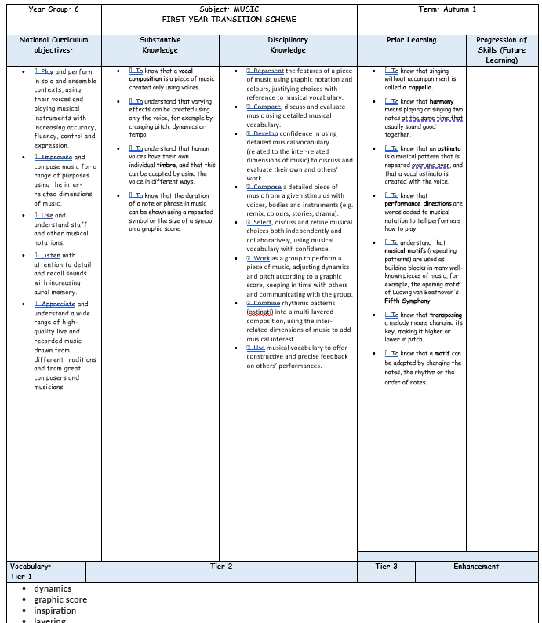
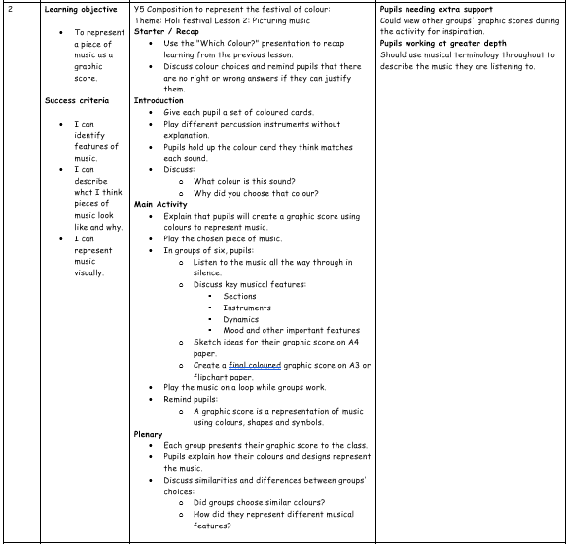
Planning
Planning follows the KAPOW scheme of work and is adapted for each class. NC links, substantive and disciplinary knowledge, prior and future learning are identified. Key vocabulary, outcomes and cross-curricular links are also identified.
Each lesson is broken down into easy-to-follow steps, adapted for the class needs with clear learning objectives, success criteria and key adaptation.

Slide 15
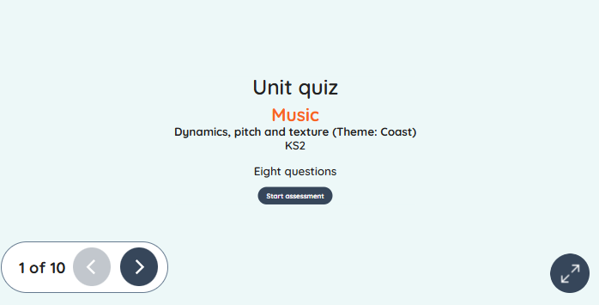
Assessment
Formative assessment in KS2 Music is an ongoing process that allows teachers to monitor pupils’ developing musical skills, knowledge, and understanding across areas such as performance, composition, listening, and appraisal. Through observation, questioning, rehearsal, and practical activities, teachers can identify pupils’ strengths and any misconceptions in real time, adapting lessons to support progress and deepen learning. The KAPOW Music scheme supports this process through its end-of-unit assessment quizzes, which provide a structured way to check pupils’ understanding of key musical concepts, vocabulary, and learning objectives. These quizzes, alongside ongoing formative assessment in lessons, help teachers to make accurate judgements about progress and ensure that pupils build their skills progressively and confidently over time.

Slide 16
Monitoring
Learning walks and lesson observations.
Pupil voice interviews and surveys.
Work scrutiny.
Analysis of assessment data, including KAPOW assessment quizzes.
Review of curriculum coverage and progression.
Scrutiny of teacher planning.
Staff voice and confidence surveys.
Moderation of pupil work across year groups.
Evaluation of technology and resource use.
Tracking pupil progress over time.
Reporting findings to governors and senior leaders.

Slide 17
Role of the Governor
The curriculum governor and education committee play an important role in supporting and monitoring the quality of music education across KS2 at Meadowhead Juniors.
Working alongside the Music Subject Leader, the governor gains an understanding of how the curriculum is implemented, the progress pupils are making, and how statutory requirements are being met. This may involve reviewing subject leader reports, discussing assessment information, visiting the school to meet pupils and staff, and monitoring the impact of curriculum developments.
The role is not to evaluate individual teachers, but to provide strategic oversight, offer support and challenge where appropriate, and report back to the governing board to ensure that music remains a high-quality and effective part of the curriculum.

Slide 18
Equal Opportunities
1. All pupils will have equal access to the entire music curriculum
2. Gender, learning ability, physical ability, ethnicity, linguistic ability and/or cultural circumstances will not impede pupils from accessing all music lessons.
3. Where it is inappropriate for a pupil to participate in a lesson because of reasons related to any of the factors outlined above, the lessons will be adapted to meet the pupil’s needs and alternative arrangements involving extra support, will be provided where necessary.
4. All efforts will be made to ensure that cultural and gender differences will be positively reflected in all lessons and teaching materials used.
5. Meadowhead Juniors aims to provide more academically able pupils with the opportunity to extend their thinking through extension activities such as providing further enquiry questions.

Slide 19
Evidence

Slide 20
Evidence

Slide 21
Evidence

