Slide 1

Religious Education

Slide 2
Religious Education Policy
Policy Title | Religious Education Policy
Ratified by | Jason Newsham
Subject Leader | Hannah Barnes
Date ratified | October 2026
Review date | October 2027
Named governor

Slide 3
Role of the Subject Leader
The RE Subject Leader is responsible for leading and developing the Religious Education curriculum across Key Stage 2, ensuring that it is engaging, progressive, and aligned with the agreed local syllabus and school expectations. They support teachers with planning, resources and professional development, while monitoring the quality of teaching and learning through activities such as learning walks, work scrutiny, pupil voice and assessment analysis. The subject leader also evaluates pupil progress, promotes pupils’ knowledge and understanding of Christianity, other major world religions and non-religious worldviews and ensures that pupils have opportunities to ask questions, explore beliefs, consider different perspectives and reflect on their own ideas. They work with senior leaders to identify strengths and areas for improvement, ensuring that the Questful RE scheme is implemented effectively and that key concepts, vocabulary and the Christian faith are developed progressively. Through these responsibilities, they help ensure that all pupils develop the knowledge, understanding, respect and confidence needed to engage thoughtfully with different beliefs, values and worldviews.

Slide 4
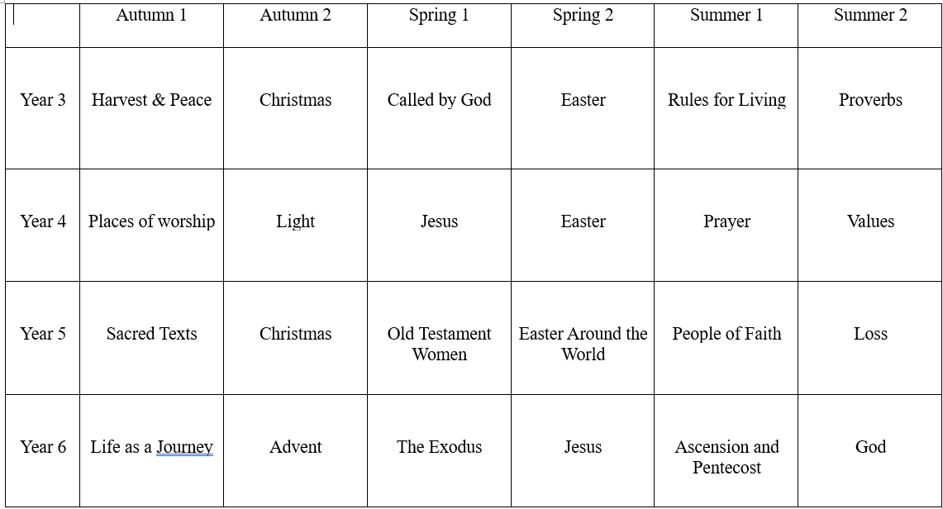
Overview

Slide 5
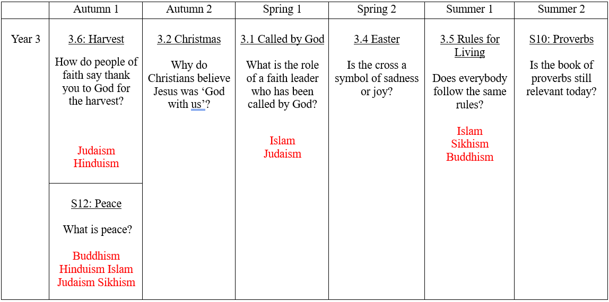
Overview – Year Three

Slide 6
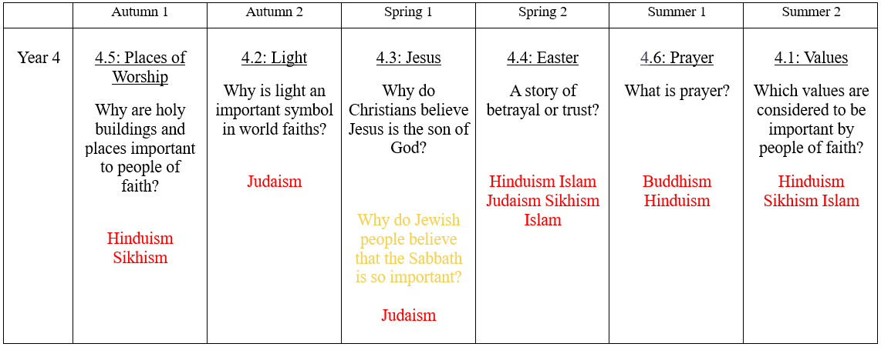
Overview – Year Four

Slide 7
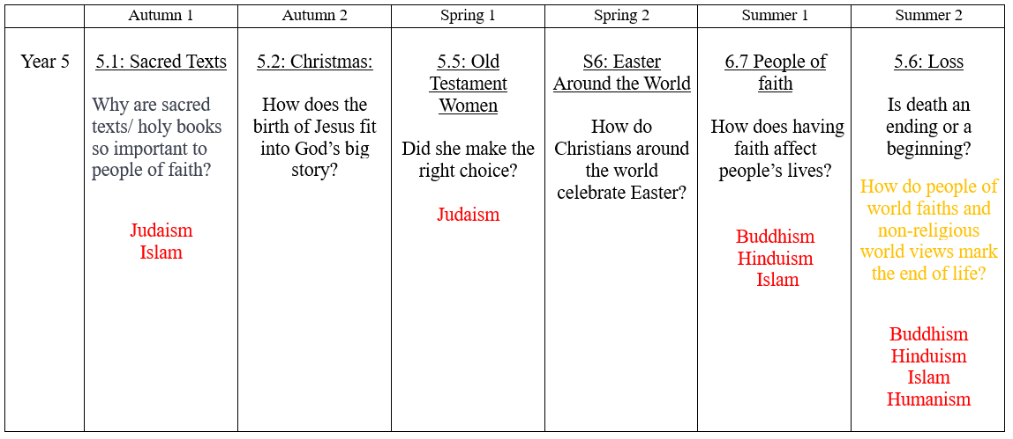
Overview – Year Five

Slide 8
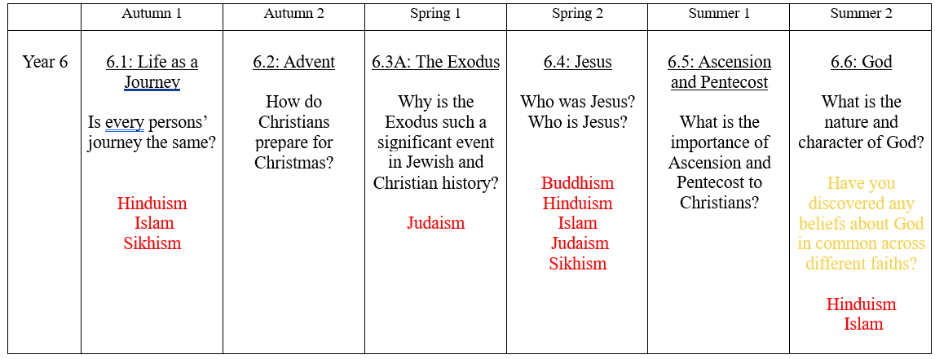
Overview – Year Six

Slide 9
Intent
At Meadowhead Junior School, our intent for Religious Education is to deliver a high-quality, enquiry-based RE curriculum that follows Questful RE, the Blackburn Diocesan Board of Education syllabus. Our curriculum recognises that rather than simply acquiring information, quality RE leads to wisdom, knowledge and understanding.
By embracing the explicit teaching of Christian concepts, the Questful RE syllabus enables pupils to develop a deep and coherent understanding of Christianity. In addition, through the exploration of all major world faiths and discussion of non-religious world views, pupils gain the knowledge and understanding needed to engage thoughtfully with life’s experiences, both now and in the future.
Questful RE acknowledges that whoever we are, wherever we live, whether we are a person of faith or not, we all have a view of the world. Through carefully structured enquiry questions, pupils are encouraged to explore, challenge and reflect upon these views in a respectful and informed way. This supports the development of religious literacy, critical thinking and personal reflection, while contributing positively to pupils’ spiritual, moral, social and cultural development. Pupils will experience, explore and encounter a wide range of creative and challenging multisensory activities that will help them to discover the answers to fundamental questions such as these: –
Who am I and what does it mean to be me?
In what ways do/can I relate to others?
How/where can I encounter God?
How can I make a positive contribution to the world in which I live?
What values, attitudes, beliefs and behaviour are important to me?
What does it mean to have faith?
Who/what influences and inspires me?

Slide 10
Implementation
The Questful RE scheme provides a carefully sequenced and progressive curriculum that builds knowledge and understanding over time.
Key elements of implementation include:
A concept-led, spiral curriculum that revisits and deepens understanding of key religious concepts
Clear progression in both substantive knowledge (beliefs, teachings and practices) and disciplinary knowledge (how religion and worldviews are explored and understood)
Use of high-quality resources and stimuli such as stories, sacred texts, artefacts and real-life examples
Regular opportunities for discussion, debate and reflection, allowing pupils to express and justify their ideas respectfully
Explicit teaching of religious vocabulary, enabling pupils to communicate their understanding with increasing confidence and accuracy
RE is taught regularly across KS2 in accordance with the agreed syllabus, with lessons adapted to ensure accessibility, inclusion and challenge for all learners.

Slide 11
Impact
Pupils:
Demonstrate a secure and progressively developing understanding of Christianity, other major world religions and non-religious worldviews, making links between different beliefs, teachings, practices and ways of life.
Develop a secure knowledge of key religious concepts, stories, teachings and vocabulary, using appropriate terminology to explain and communicate their understanding with increasing accuracy and depth.
Understand key aspects of the Christian faith and the Christian ‘big story’, including how beliefs about God, Jesus, salvation and the Bible influence Christian beliefs and practices.
Ask thoughtful and increasingly challenging questions about religion, belief, meaning and values, using evidence and their developing knowledge to explore and respond to different viewpoints.
Develop the ability to reflect on their own ideas, experiences and values, considering how these may be similar to or different from the beliefs and perspectives of others.
Recognise that religions and worldviews are diverse and that individuals within the same faith or worldview may hold different beliefs and interpretations.
Demonstrate respect, empathy and understanding when discussing different religions, beliefs and worldviews, contributing positively to thoughtful and sensitive discussions.
Demonstrate increasing confidence in expressing, explaining and justifying their own ideas, while listening carefully to and considering the perspectives of others.
By the end of KS2, pupils are well prepared for the next stage of their education, having developed a secure foundation of religious and worldview knowledge alongside the ability to question, interpret, reflect and respond thoughtfully. Through their learning in Questful RE, pupils develop the knowledge, vocabulary and critical thinking skills needed to engage respectfully and positively with a diverse, multi-faith and multi-worldview society.

Slide 12
Teaching and Learning
All learners, regardless of their individual starting point, will have access to the RE curriculum and it is for each teacher to adapt their teaching to enable this.
To facilitate learning in RE, it is considered good practice to ensure that:
• The purpose of each lesson is made clear and pupils understand the knowledge, concepts or questions they are exploring.
• Appropriate learning experiences are planned and meet the needs of all pupils in the class (see inclusion below and our SEND Policy) and draw upon pupils' own experiences, existing knowledge and understanding.
• Lessons provide a range of opportunities for pupils to learn, practise and demonstrate their knowledge and understanding, while also asking questions, discussing ideas and engaging critically with different beliefs and viewpoints.
• The Questful RE curriculum provides opportunities for pupils to develop a secure understanding of Christianity, other major world religions and non-religious worldviews, making meaningful connections between beliefs, teachings, practices and values.
• Religious vocabulary and key concepts are explicitly taught, modelled and revisited to enable pupils to communicate their ideas accurately and with increasing confidence.
• Time is given for pupils to reflect, consolidate and apply their learning in different contexts, including opportunities to consider how beliefs and values may influence the lives of individuals and communities.
• Pupils are encouraged to take responsibility for their own learning, ask thoughtful questions and reflect on their own ideas, beliefs, values and responses.
• Attention is given to developing a safe, respectful and inclusive classroom climate where pupils feel confident to express their ideas, listen to different viewpoints and engage in sensitive discussions.
• Staff training needs are met to ensure that teachers have the subject knowledge, confidence and resources required to deliver high-quality RE.
• Visitors, visits and opportunities to engage with members of different faith communities are provided where appropriate to broaden pupils' understanding and provide meaningful opportunities to learn about religion and worldviews.

Slide 13
Inclusion
Pre-teach and reinforce religious vocabulary (e.g. belief, worship, salvation, incarnation, covenant, pilgrimage, scripture and worldview) using visual word mats, symbols, images and child-friendly definitions to support pupils in understanding and using key terminology.
Break down complex religious concepts and questions into small, manageable steps using clear explanations, visual resources, stories, examples, structured questioning and teacher modelling to support pupils in developing their understanding.
Use visual and practical supports throughout Questful RE units, including photographs, artefacts, symbols, religious texts, storyboards, timelines, diagrams and video clips to provide different ways for pupils to access and explore religious beliefs, practices and worldviews.
Provide scaffolded versions of Questful RE activities by using sentence stems, writing frames, sorting activities, matching tasks, partially completed diagrams and structured discussion prompts to reduce cognitive demands while maintaining the intended learning objectives.

Slide 14
Inclusion
Provide scaffolded versions of Questful RE activities by using sentence stems, writing frames, sorting activities, matching tasks, partially completed diagrams and structured discussion prompts to reduce cognitive demands while maintaining the intended learning objectives.
Provide opportunities for structured discussion and reflection through paired talk, small-group activities and carefully planned questions, enabling pupils who may find verbal or written expression difficult to share their ideas and consider different beliefs and viewpoints.
Use appropriate adaptations and additional support for pupils with SEND, including simplified texts, enlarged or symbol-supported resources, additional processing time, adult or peer support and alternative ways of recording learning where appropriate.
Create a safe and respectful environment where all pupils feel confident to ask questions, express their ideas and engage with different religious and non-religious viewpoints, while recognising that beliefs and practices can vary between individuals and communities.

Slide 15

OFSTED
On the 12th May 2021, Ofsted published a literature review with the aim of identifying the factors which contribute to a high-quality RE curriculum. The guidance covers all aspects of the RE curriculum, from early years to A-level.
For the full document, with the research and reasoning supporting these recommendations, click here
Summary:
High-quality RE may have the following features:
A consideration of the knowledge that pupils build through the RE curriculum, because accurate knowledge about religion and non-religion can be beneficial for achieving different purposes and aims for RE.
High expectations about scholarship in the curriculum to guard against pupils’ misconceptions. What is taught and learned in RE is grounded in what is known about religion/non-religion from academic study (scholarship).
Carefully selected and well-sequenced substantive content and concepts.
‘Ways of knowing’ are appropriately taught alongside the substantive content and are not isolated from the content and concepts that pupils learn.
A consideration of when pupils should relate the content to their own personal knowledge (for example, prior assumptions).

Slide 16
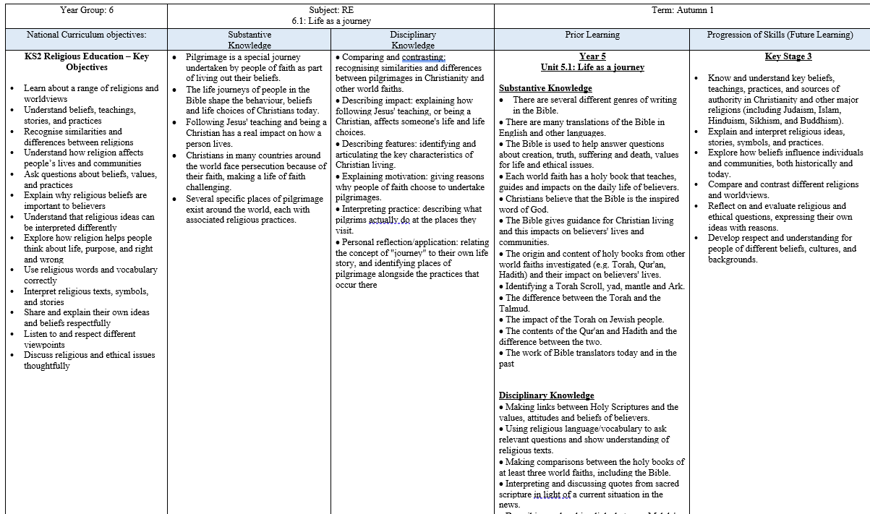
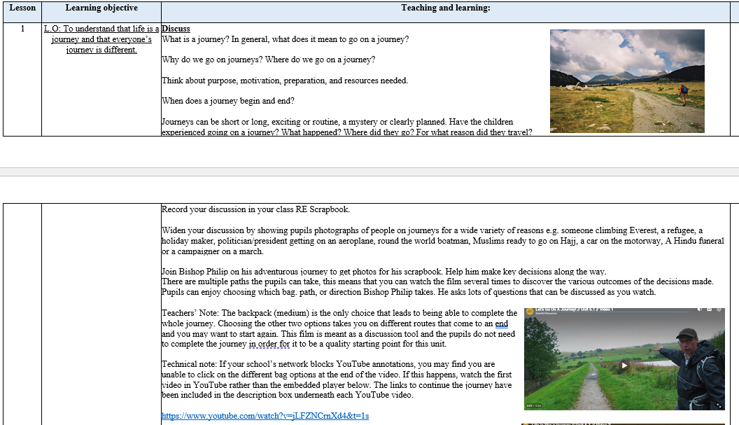
Planning
Planning follows the Questful RE scheme of work and is adapted for each class. NC links, substantive and disciplinary knowledge, prior and future learning are identified. Key vocabulary, outcomes and cross-curricular links are also identified.
Each lesson is broken down into easy-to-follow steps, adapted for the class needs with clear learning objectives, success criteria and key adaptation.

Slide 17
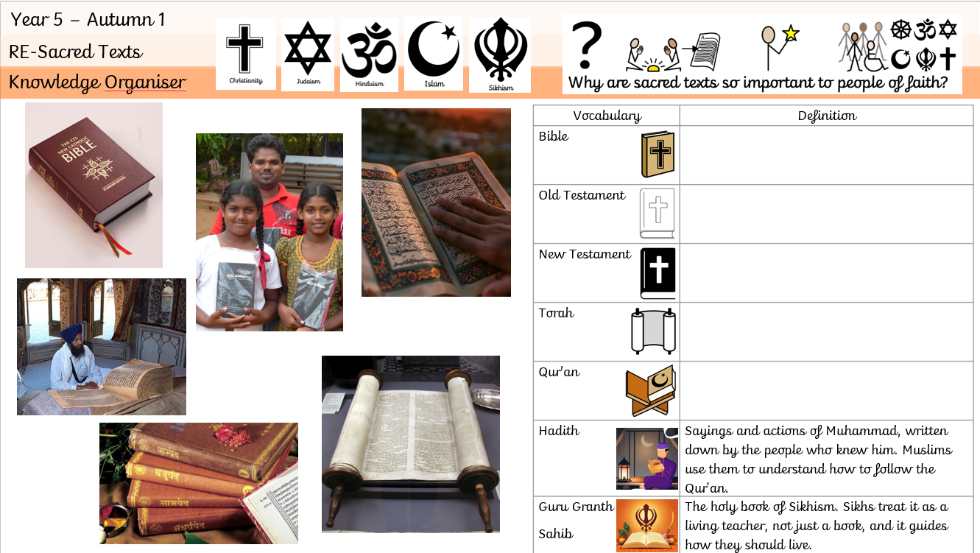
Planning
Knowledge organisers are used to support pupils in remembering and revisiting the key knowledge, vocabulary and concepts from a unit of work. They provide a clear and accessible summary of the most important learning, helping pupils to make connections between new and prior knowledge. Knowledge organisers also support retrieval practice, independent learning and home-school communication, ensuring that all pupils, including those with SEND, have a consistent reference point throughout their learning journey.
Key learning is noted around the knowledge organiser.

Slide 18

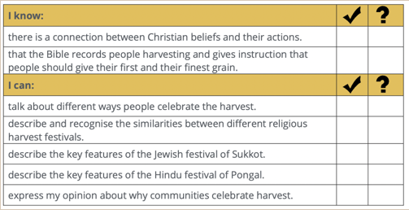
Assessment
Formative assessment in RE is an ongoing process that helps teachers identify pupils’ understanding, misconceptions and progress throughout a unit of work. By using questioning, observation, discussion, written tasks, retrieval activities and opportunities for pupils to explain and reflect on their ideas, teachers can gather evidence of learning and adapt teaching to meet pupils’ needs. The Questful RE scheme supports assessment by providing clear learning outcomes and opportunities to assess pupils’ knowledge and understanding of key concepts, religious beliefs, practices, stories and vocabulary. Teachers use pupils’ responses, discussions and recorded work to evaluate how well learning objectives have been met, identify areas that may require further teaching or consolidation, and inform future planning. Assessment also considers pupils’ ability to make connections between beliefs, practices and values, ask thoughtful questions, consider different viewpoints and reflect on their own ideas. Combined with regular classroom assessment strategies, Questful RE supports pupils in making secure progress in their religious knowledge and understanding while developing the ability to think critically, reflect deeply and engage respectfully with a range of religions and worldviews.

Slide 19
Monitoring
• Learning walks and lesson observations.
• Pupil voice interviews and surveys.
• Work scrutiny of RE books, written outcomes and recorded reflections.
• Analysis of assessment information and pupils' progress over time.
• Review of curriculum coverage and progression of religious knowledge, concepts and vocabulary.
• Scrutiny of teacher planning and implementation of the Questful RE scheme.
• Monitoring of pupils' understanding of Christianity, other major world religions and non-religious worldviews.
• Monitoring of opportunities for questioning, discussion, reflection and consideration of different viewpoints.
• Staff voice and confidence surveys.
• Moderation of pupil work across year groups.
• Evaluation of RE resources, artefacts and enrichment opportunities.
• Monitoring of SEND adaptations and accessibility within RE lessons.
• Reporting findings to governors and senior leaders.

Slide 20
Role of the Governor
The curriculum governor and education committee play an important role in supporting and monitoring the quality of RE across KS2 at Meadowhead Juniors.
Working alongside the RE Subject Leader, the governor gains an understanding of how the curriculum is implemented and the progress pupils are making. This may involve reviewing subject leader reports, discussing assessment information, visiting the school to meet pupils and staff and monitoring the impact of curriculum developments.
The role is not to evaluate individual teachers, but to provide strategic oversight, offer support and challenge where appropriate, and report back to the governing board to ensure that RE remains a high-quality and effective part of the curriculum.

Slide 21
Equal Opportunities
1. All pupils will have equal access to the entire RE curriculum
2. Gender, learning ability, physical ability, ethnicity, linguistic ability and/or cultural circumstances will not impede pupils from accessing all RE lessons.
3. Where it is inappropriate for a pupil to participate in a lesson because of reasons related to any of the factors outlined above, the lessons will be adapted to meet the pupil’s needs and alternative arrangements involving extra support, will be provided where necessary.
4. All efforts will be made to ensure that cultural and gender differences will be positively reflected in all lessons and teaching materials used.
5. Meadowhead Juniors aims to provide more academically able pupils with the opportunity to extend their thinking through extension activities such as providing further enquiry questions.

Slide 22
NATRE – Withdrawal requests
Parental Right to Withdraw from RE
Religious Education (RE) is a statutory part of the curriculum, and parents have a legal right to withdraw their child from all or part of RE. Parents are not required to provide a reason for their request. This right applies to pupils in different types of schools, including schools with and without a religious designation.
Where a parent is considering withdrawal, NATRE recommends that the school provides an opportunity to discuss the request with the Headteacher. Parents should be given clear information about the aims and content of the school's RE curriculum, including the locally agreed syllabus and examples of the learning pupils undertake. This can help parents make an informed decision about whether they wish to withdraw their child.
Parents may request withdrawal from the whole RE curriculum or specific parts of it, and a school cannot refuse a request for partial withdrawal. However, the right of withdrawal applies specifically to RE and does not extend to other curriculum subjects where religious content may arise, such as History or Art and Design.
If a pupil is withdrawn, the school has a responsibility to supervise the pupil during the RE lesson but is not required to provide alternative teaching or incur additional costs. Where parents wish their child to receive an alternative form of religious education, NATRE explains that arrangements are the responsibility of the parents and should not disrupt the child's wider education.
NATRE also recommends that schools review withdrawal arrangements with parents annually and ensure that information about the school's inclusive approach to RE is communicated clearly through its website, prospectus and other appropriate channels.
In our school, parents wishing to withdraw their child from RE should contact the Headteacher to discuss their request and clarify which aspect of the curriculum they wish their child to be withdrawn from. The school will respect the parent's legal right while continuing to provide an inclusive, broad and balanced RE curriculum for all other pupils.
For further information, click here.

Slide 23
Evidence

Slide 24
Evidence

Slide 25
Evidence

