Slide 1

History

Slide 2
Computing Policy
Control Page
Policy Title | History Policy
Ratified by | J. Newsham
Date ratified | September 2026
Name of responsible individual | H.Livesey
Review date | September 2027

Slide 3
Role of the Subject Leader
The KS2 History Subject Leader is responsible for leading and developing the History curriculum across Key Stage 2, ensuring that it is engaging, progressive, and aligned with the National Curriculum. They support teachers with planning, resources, and professional development, while monitoring the quality of teaching and learning through activities such as lesson observations, work scrutiny, pupil voice, and assessment analysis. The subject leader also evaluates pupil progress, hears what the children say about history and works with senior leaders to identify strengths and areas for improvement. Through these responsibilities, they help ensure that all pupils develop the knowledge, skills, and confidence needed to become curious historians.

Slide 4
Overview
History | Autumn 2 | Spring 2 | Summer 2
Year 3 | Stone age to Iron age Enquiry question: How did children's lives change in prehistory? | Early Civilization – Egypt Enquiry question: How important were waterways to ancient civilisations? | The Roman Empire Enquiry question: What role did the fort at Ribchester play in helping maintain and consolidate Roman rule in Britain?
Year 4 | Local History - Blackburn and the Industrial Revolution Enquiry question: What impact did James Hargreaves have on the trade industry in Blackburn? | Ancient Greece Enquiry question: How did the important values of Athenians and Spartans influence their different styles of leadership? | The Great Plague Enquiry question: Why did the villagers of Eyam choose to quarantine themselves during The Great Plague?
Year 5 | Local History – Milling & Migration Enquiry question: How significant was the Lancashire cotton industry for the people of Lancashire and beyond? | Anglo-Saxons and Scots Enquiry question: What did the Sutton Hoo discoveries tell us about the Anglo-Saxons? | Early Civilization – Early Islamic civilization Enquiry question: Why was the ancient city of Baghdad so significant?
Year 6 | British History beyond 1066 – World War II Enquiry question: Why were children evacuated during WW2? | Viking vs Anglo-Saxons Enquiry question: Is it fair to describe all Vikings as Brutal warriors? | Crime and punishment Enquiry question: What do we mean by crime and punishment and how has it changed over time?

Slide 5

Intent
A high-quality history education will help pupils gain a coherent knowledge and understanding of Britain’s past and that of the wider world. It should inspire pupils’ curiosity to know more about the past. Teaching should equip pupils to ask perceptive questions, think critically, weigh evidence, sift arguments, and develop perspective and judgement. History helps pupils to understand the complexity of people’s lives, the process of change, the diversity of societies and relationships between different groups, as well as their own identity and the challenges of their time.
At Meadowhead Juniors, we believe that children should leave our school with a passion for history. Our curriculum inspires pupils to be curious about Britain’s past and that of the wider world. We want children to enjoy and love learning about history by gaining the relevant knowledge and skills, not just through experiences in the classroom, but also with the use of fieldwork and educational visits.
Our curriculum will ensure a progression of skills and knowledge throughout each Key Stage focused on the National Curriculum based on the needs of our pupils in our school.
It will follow guidelines set out in: DfE (2013) ‘National curriculum in England: geography programmes of study’ DfE (2021) Statutory EYFS Framework Children will be taught a range of knowledge of skills throughout their time at Meadowhead Junior.

Slide 6
Intent – The History Curriculum
The aims of the history curriculum are to ensure pupils:
• Know and understand the history of the UK, and how it shaped the world, as a coherent, chronological narrative, from the earliest times to the present day.
• Know and understand significant aspects of the history of the wider world, such as ancient civilisations; empires and past non-European societies and deploy a historically grounded understanding of abstract terms such as ‘empire’, ‘civilisation’, ‘parliament’ and ‘peasantry’.
• Understand historical concepts, such as continuity and change, cause and consequence, similarity, difference and significance, and use these to analyse.
• Understand the methods of historical enquiry such as using evidence to support arguments.
• Gain a historical perspective by placing their growing knowledge into different contexts, understanding the connections between local, regional, national and international history. Pupils should be taught about:
• In relation to Britain; the Stone Age to the Iron Age, the Roman Empire, the Anglo Saxons and Scots, the Vikings to the time of Edward the Confessor.
• The earliest civilisations.
• Studies on local history, an aspect of British history beyond 1066, Ancient Greece, a non-European society such as Baghdad c. AD 900 and another ancient civilisation.

Slide 7
Implementation – teaching & learning
The History Coordinator will be responsible for overseeing the planning, resourcing and monitoring of the school’s history programme. The subject matter covered in history reflects the requirements of the new National Curriculum, which came into effect on 1 September 2014. Special focus will be paid to the teaching of the skills inherent in the entire history curriculum taught at Meadowhead Junior School.
These skills include:
• Making accurate observations.
• Asking and answering questions.
• Effectively using the appropriate sources for making judgements
• Recognising patterns and identifying relationships.
• Predicting and applying knowledge to differing contexts.
• Critically analysing and interpreting evidence, and drawing conclusions.
The history programme will be delivered by all staff in a range of teaching and learning situations with respect to the needs of individual pupils.

Slide 8
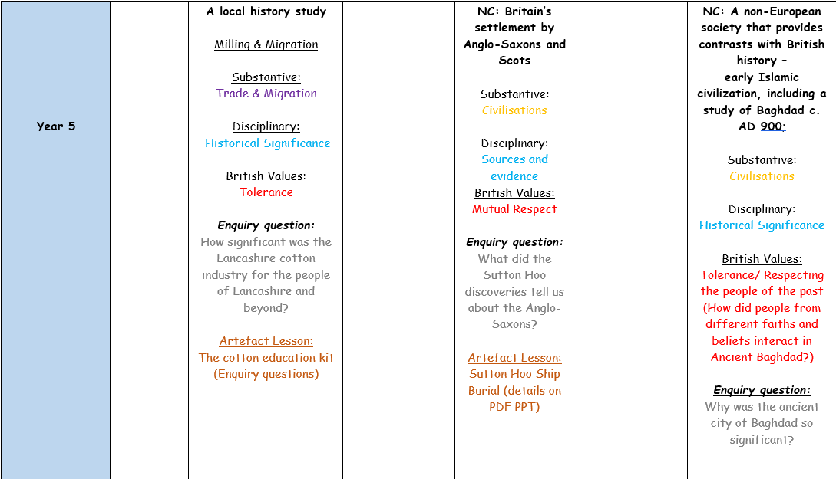
Implementation
Curriculum Overviews
Unit name
Substantive Knowledge
Disciplinary knowledge
British Value link
Enquiry question
Artefact lesson to start topic
Notes:
What do these look like?
Screenshot example of a unit showcasing enquiry question, retrieval opps, vocab and objectives

Slide 9
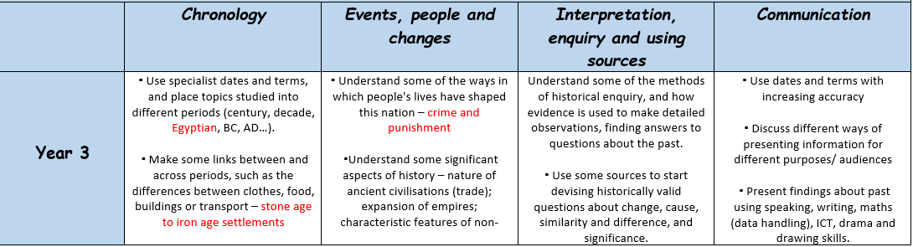
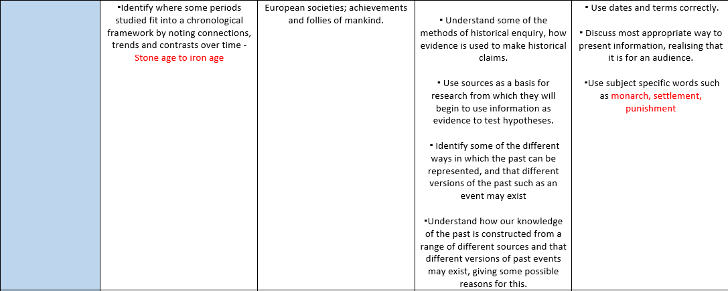
Implementation
Curriculum Overviews
Each unit has been carefully planned where there is a sequence of skill progression in the four main areas: chronology; events, people and changes; interpretation, enquiry and using sources and communication.
Teachers have access to the resources which indicated a clear progression of skills and which units the skills will be developed further.
Notes:
What do these look like?
Screenshot example of a unit showcasing enquiry question, retrieval opps, vocab and objectives

Slide 10
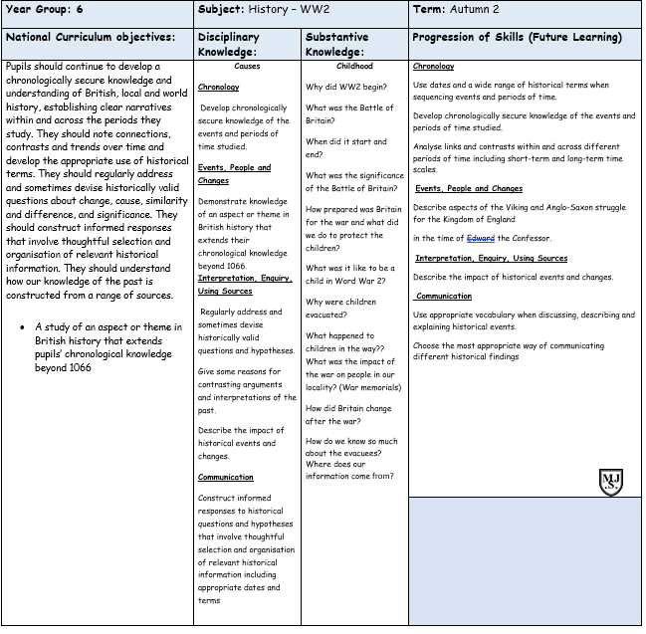
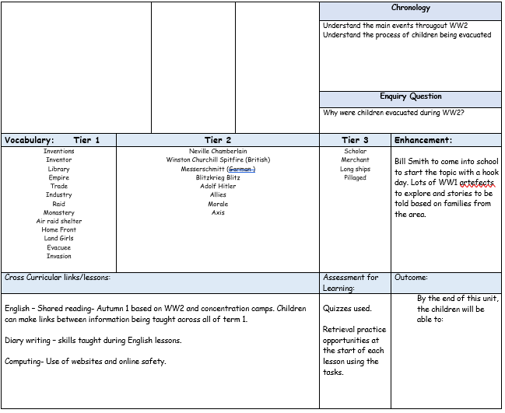
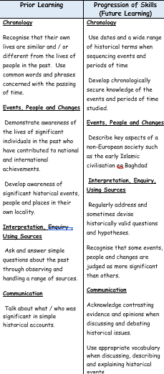
Implementation
Curriculum Overviews
Prior and future learning
Substantive knowledge and enquiry questions
Vocabulary progression
National Curriculum objectives
Disciplinary knowledge
Cross-curricular links
Curriculum enhancements
Notes:
What do these look like?
Screenshot example of a unit showcasing enquiry question, retrieval opps, vocab and objectives

Slide 11
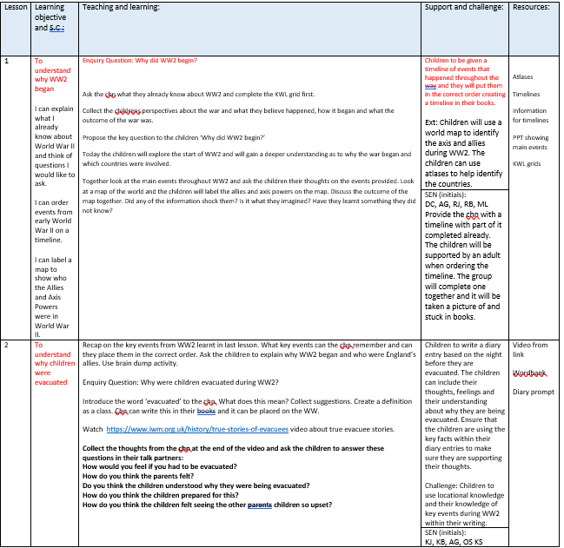
Implementation
Curriculum Overviews
Lesson objectives
Success Criteria (Steps to success)
Deeper learning opportunities
Adaptation and scaffolding
Notes:
What do these look like?
Screenshot example of a unit showcasing enquiry question, retrieval opps, vocab and objectives

Slide 12
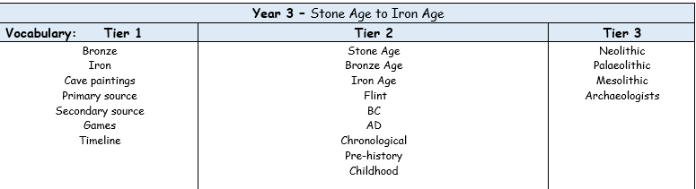
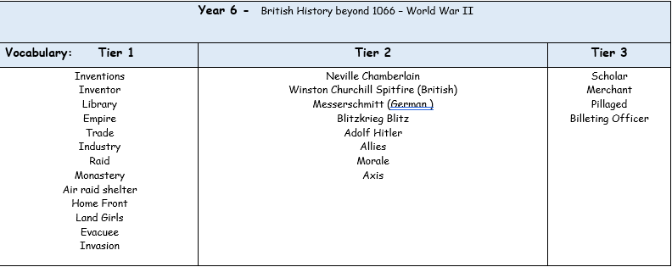
Implementation
Curriculum Overviews
Tiered vocabulary provided for each unit covered from Year 3 to 6. This allows for progression in vocabulary throughout KS2. Teachers are aware of the prior vocabulary and which words they will be using in future learning.
Notes:
What do these look like?
Screenshot example of a unit showcasing enquiry question, retrieval opps, vocab and objectives

Slide 13
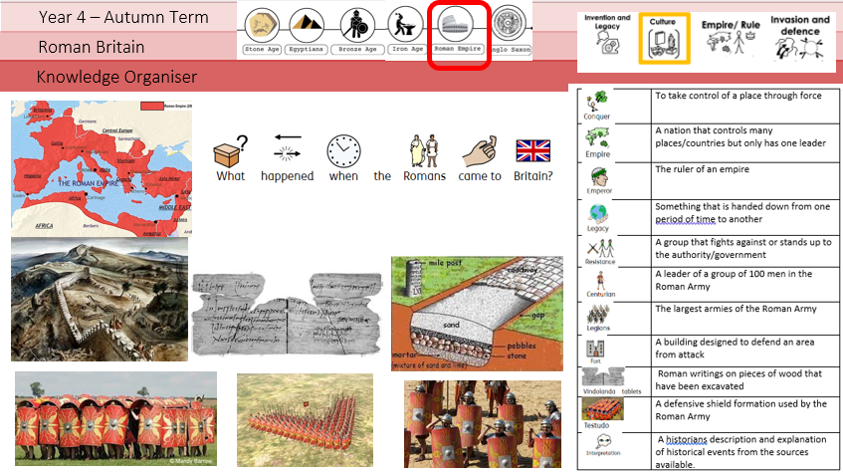
Planning
Knowledge organisers are used to support pupils in remembering and revisiting the key knowledge, vocabulary and concepts from a unit of work. They provide a clear and accessible summary of the most important learning, helping pupils to make connections between new and prior knowledge. Knowledge organisers also support retrieval practice, independent learning and home-school communication, ensuring that all pupils, including those with SEND, have a consistent reference point throughout their learning journey.
Key learning is noted around the knowledge organizer in ‘knowledge nuggets’.

Slide 14
Inclusion
Pre-teach and reinforce computing vocabulary (e.g. algorithm, debug, sequence, variable, input/output) using visual word mats and symbol-supported definitions before Kapow Computing lessons.
Break down programming tasks in Scratch and other coding units into small, manageable steps with checklists, worked examples and screenshots to support understanding and independence.
Use visual supports throughout Kapow Computing units, including Now/Next boards, colour-coded coding blocks, visual success criteria and modelled demonstrations for Computing Systems, Programming, Data Handling and Digital Media lessons.
Provide scaffolded versions of Kapow activities by using templates, partially completed projects, pre-filled spreadsheets and structured planning sheets to reduce cognitive demands while maintaining learning objectives.

Slide 15
Inclusion
Support communication and explanation of computing concepts through sentence stems such as "I debugged my program by..." or "The data shows..." rather than relying solely on written responses.
Adapt assessment opportunities within Kapow Computing by allowing pupils to demonstrate learning through practical demonstrations, verbal explanations, screen recordings or teacher discussion instead of extended written work.
Make abstract computing concepts more concrete by using physical resources and real-life examples, such as sorting hardware devices in Computing Systems units or using real objects before introducing data collection and spreadsheets.
Increase engagement and independence across all Kapow strands by offering structured choices, regular feedback, movement breaks, assistive technology and clear support prompts, enabling SEND pupils to access Programming, Data, Digital Media, Online Safety and Computing Systems learning more successfully.

Slide 16
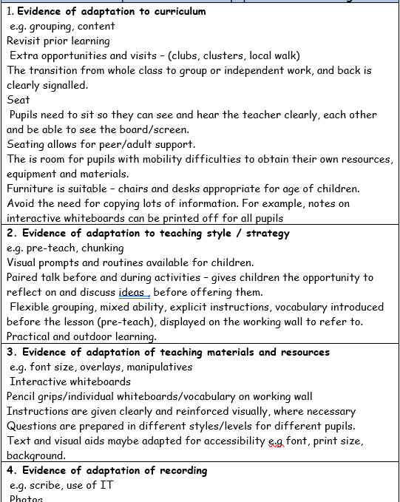
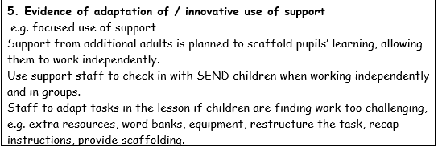
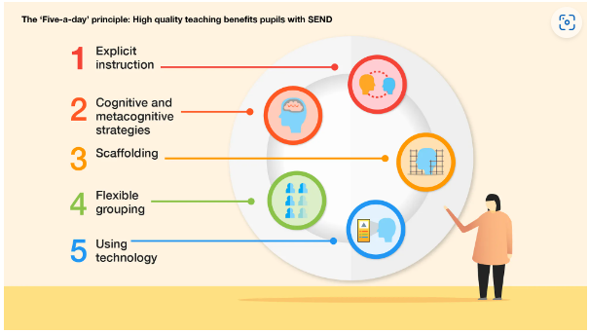
Inclusion

Slide 17
Impact – Assessment, Recording & Reporting
Assessment
Assessment in History is an integral part of teaching and learning and is used to monitor pupils’ progress against the National Curriculum objectives. Learning objectives and success criteria are shared with pupils, who work towards an overarching enquiry question throughout each unit.
Assessment includes questioning, observation, classwork, peer and self-assessment, and teacher assessment. Pupils are encouraged to reflect on their learning, recognise the standards they are working towards, and identify their next steps. Teachers provide subject-specific feedback to support pupils in making progress.
Teachers and pupils regularly review and reflect on assessment information to inform future teaching and learning.
Meeting the Needs of All Pupils
We recognise that pupils have a wide range of abilities and learning needs. History teaching is therefore appropriately adapted to provide suitable levels of challenge and support for all pupils. Tasks, resources, questioning and outcomes are differentiated where appropriate to ensure that all pupils can access the curriculum, develop their historical knowledge and skills, and make progress.

Slide 18

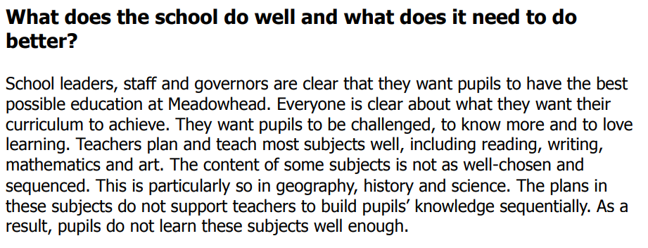
Ofsted Review

Slide 19
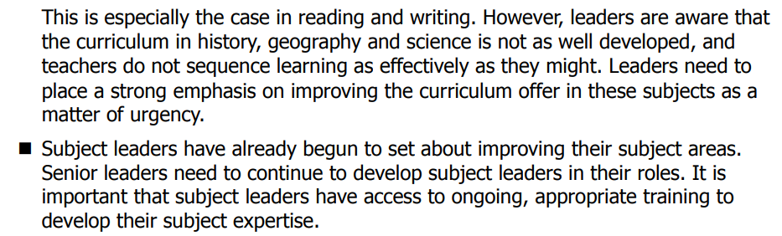
Ofsted Review

Slide 20
Ofsted Summary
History to be well-sequenced to aid consistency and progression throughout the whole school.
To ensure that teachers are confident in the planning and teaching of history.

Slide 21
Assessment
Formative assessment in KS2 History is an ongoing process that enables teachers to identify pupils’ understanding, misconceptions and progress throughout each unit of work. Through questioning, observation, discussion, historical enquiry and practical activities, teachers gather evidence of learning and adapt teaching to meet the needs of all pupils.
History units are supported by teacher-created quizzes based on the key enquiry questions explored throughout each lesson. These quizzes provide opportunities for teachers to assess pupils’ knowledge and understanding, evaluate how well learning objectives have been achieved, and identify areas that require further teaching, consolidation or challenge.
Prior learning activities at the beginning of lessons provide an opportunity for pupils to recall and apply previously taught knowledge. These activities enable teachers and support staff to identify and address misconceptions, strengthen pupils’ historical understanding and make meaningful links between prior and new learning.
Formative assessment is used to inform future planning and ensure that pupils develop both their historical knowledge and disciplinary skills progressively throughout KS2.

Slide 22
Monitoring
Learning walks and lesson observations.
Pupil voice interviews and surveys.
Work scrutiny of digital and written outcomes.
Analysis of assessment data, including assessment quizzes.
Review of curriculum coverage and progression.
Scrutiny of teacher planning.
Monitoring of resources needed and what is being used.
Staff voice and confidence surveys.
Moderation of pupil work across year groups.
Tracking pupil progress over time.
Reporting findings to governors and senior leaders.

Slide 23
Role of the Governor
The History Link Governor plays an important role in supporting and monitoring the quality of history education across KS2 at Meadowhead Juniors.
Working alongside the History Subject Leader, the governor gains an understanding of how the curriculum is implemented, the progress pupils are making, and how statutory requirements are being met. This may involve reviewing subject leader reports, discussing assessment information, visiting the school to meet pupils and staff, and monitoring the impact of curriculum developments.
The role is not to evaluate individual teachers, but to provide strategic oversight, offer support and challenge where appropriate, and report back to the governing board to ensure that History remains a high-quality and effective part of the curriculum.

Slide 24
Equal Opportunities
1. All pupils will have equal access to the entire computing curriculum
2. Gender, learning ability, physical ability, ethnicity, linguistic ability and/or cultural circumstances will not impede pupils from accessing all computing lessons.
3. Where it is inappropriate for a pupil to participate in a lesson because of reasons related to any of the factors outlined above, the lessons will be adapted to meet the pupil’s needs and alternative arrangements involving extra support, will be provided where necessary.
4. All efforts will be made to ensure that cultural and gender differences will be positively reflected in all lessons and teaching materials used.
5. Meadowhead Junior School aims to provide more academically able pupils with the opportunity to extend their thinking through extension activities such as providing further enquiry questions.

Slide 25
Pupil voice
We’ve learnt that some Vikings were brutal and learnt about the weapons they used.
I found history interesting because I learnt about where the Anglo-Saxons travelled from and the pull and push reasons why.
The ancient Egyptian civilisation began 5000 years ago and lasted around 3000 years.

Slide 26
Evidence

Slide 27
Evidence

Slide 28
Evidence

