Slide 1

Physical Education

Slide 2
Physical Education Policy
Policy Title | Physical Education Policy
Ratified by | Jason Newsham
Subject Leader | Afzal Alli
Date ratified | October 2026
Review date | October 2027
Named governor

Slide 3
Role of the Subject Leader
The KS2 PE Subject Leader is responsible for leading and developing Physical Education across Meadowhead Juniors, ensuring that the curriculum is broad, balanced, progressive and inclusive. They oversee the implementation of the Lancashire PE Passport scheme, supporting high-quality teaching and learning that meets the requirements of the National Curriculum. The subject leader is responsible for:
Curriculum development: Ensuring the PE curriculum provides progression in physical skills, knowledge and understanding across a range of sports and physical activities.
Teaching and learning: Supporting staff to deliver engaging, high-quality PE lessons that develop pupils’ physical, cognitive, social and emotional skills.
Inclusion: Ensuring all pupils, including those with SEND, can access the PE curriculum through appropriate differentiation and adaptations, including the STEP approach (Space, Task, Equipment and People).
Assessment: Supporting staff to use PE Passport assessment tools to monitor pupils’ progress, identify strengths and inform future teaching.
Monitoring: Evaluating the quality and impact of PE through lesson visits, planning reviews, pupil voice and discussions with staff.
Staff development: Identifying training needs and supporting staff confidence and subject knowledge through shared resources and professional development.
Enrichment: Working with the Blackburn with Darwen School Games Organisers to provide opportunities for extracurricular sport, competitions and events, alongside CPD to support staff development.
Resources and provision: Ensuring appropriate equipment and resources are available and well maintained.
Physical activity and wellbeing: Promoting active lifestyles, teamwork, resilience, sportsmanship and positive attitudes towards physical activity.
School improvement: Working with senior leaders to evaluate the effectiveness of PE and identify priorities for further development.
The subject leader ensures that all pupils receive at least two hours of high-quality PE each week and have opportunities to develop their physical competence, confidence and enjoyment of sport and physical activity.

Slide 4
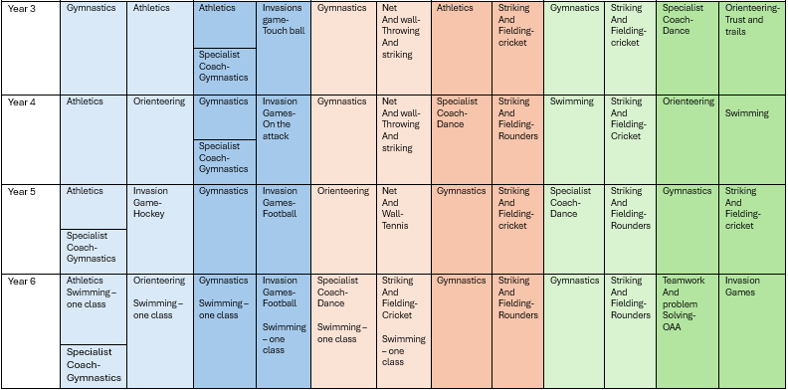
Overview

Slide 5
Intent
At Meadowhead Junior School, we believe that Physical Education plays an important role in developing the whole child. Our aim is for every pupil, regardless of their starting point or individual needs, to develop the knowledge, skills, confidence and positive attitudes needed to lead healthy, active and fulfilling lives.
Through the PE Passport scheme, we provide a broad, balanced and progressive PE curriculum that enables all pupils to achieve the aims of the National Curriculum. Pupils experience a wide range of traditional and new sports and physical activities, developing their physical competence alongside their cognitive, social and emotional skills.
We aim to develop pupils who can learn, practise, apply and evaluate physical skills and knowledge. Pupils are encouraged to understand how to improve their performance, make decisions, solve problems and work effectively with others. We also recognise the importance of providing opportunities for pupils to participate in physical activity beyond curriculum PE. Through extra-curricular clubs, competitions, festivals and sporting events, pupils are encouraged to develop their interests, experience competition and represent the school. Our links with the Blackburn with Darwen School Games Organisers (SGO) support these opportunities and contribute to the development of an inclusive and varied sporting offer.
Ultimately, we want our pupils to develop a lifelong enjoyment of physical activity, understand the importance of being active and healthy, and leave Meadowhead Juniors with the confidence and skills to participate positively in physical activity beyond primary school.

Slide 6
Implementation
PE at Meadowhead Juniors is taught through the PE Passport scheme, which provides a structured and progressive curriculum across KS2. Lessons develop pupils' physical, cognitive, social and emotional learning through a wide variety of activities and sports. All pupils receive two hours of high-quality PE each week. Staff use the PE Passport planning and resources to ensure that learning is progressive, while adapting activities and teaching approaches to meet the needs of individual pupils and groups. Teaching follows the principles of Assessment for Learning, with teachers continually assessing pupils' knowledge, understanding and physical performance. Pupils are given opportunities to receive feedback, reflect on their performance, identify areas for improvement and apply their learning in new situations.
Lessons include a range of teaching styles and strategies, including:
Teacher modelling and demonstration.
Explicit teaching and explanation of skills and techniques.
Guided and independent practice.
Partner and group activities.
Small-sided games and modified activities.
Opportunities for pupils to make decisions and solve problems.
Peer feedback and evaluation.
Appropriate support and challenge.
Pupils are provided with different levels of challenge to develop their skills, knowledge and behaviours. Activities can be adapted through STEP, allowing teachers to alter the space, task, equipment or number of participants. This ensures that pupils are appropriately supported or challenged while maintaining high expectations.
Our participation in the Blackburn with Darwen School Games programme provides additional opportunities for pupils to take part in inter-school competitions, festivals and inclusive sporting events. The School Games Organisers also support the professional development of staff through CPD opportunities, training and networking, helping to develop teachers' knowledge, confidence and expertise in delivering high-quality PE. Where appropriate, PE learning is further enhanced through sporting visitors, specialist coaches, clubs and links with the wider community.

Slide 7
Impact
Through our PE curriculum, pupils at Meadowhead Juniors develop progressively secure physical skills and knowledge across a broad range of sports and physical activities.
Pupils:
Demonstrate increasing competence, confidence and control when performing a range of physical skills.
Apply skills and knowledge effectively in different activities, games and situations.
Understand how to improve their own performance and respond positively to feedback.
Make appropriate decisions, solve problems and apply tactics and strategies during physical activities.
Demonstrate knowledge of rules, techniques and strategies across a range of sports.
Develop their physical fitness and understand the importance of regular physical activity for health and wellbeing.
Work cooperatively with others, demonstrating communication, teamwork, leadership and respect.
Show resilience, perseverance and a willingness to challenge themselves.
Experience success and have their individual achievements valued, regardless of their starting point.
Develop confidence through participation in extra-curricular activities, competitions, festivals and sporting events.
The impact of PE is monitored through ongoing assessment, observation, pupil voice, tracking of progress and evaluation of individual and group achievement. Teachers use assessment information to identify pupils requiring additional support or challenge and to inform future teaching.
By the end of KS2, pupils have developed a secure foundation of physical, cognitive, social and emotional skills. They are increasingly confident, active and resilient, understand how to improve their performance, and are equipped with the knowledge and positive attitudes needed to participate in physical activity and maintain an active lifestyle beyond Meadowhead Juniors.

Slide 8
Teaching and Learning
At Meadowhead Juniors, Physical Education is taught using the Lancashire PE Passport scheme, which provides a broad, balanced and progressive curriculum aligned with the National Curriculum. Teaching develops pupils’ physical competence, knowledge and understanding, alongside their cognitive, social and emotional skills. All pupils receive at least two hours of high-quality PE each week, regardless of weather or external factors. To facilitate effective teaching and learning in PE, it is considered good practice to ensure that:
The purpose of each lesson and the intended learning outcomes are made clear to pupils.
Lessons build progressively on prior learning, developing pupils’ fundamental movement skills, sport-specific techniques, tactical awareness and ability to apply skills in different contexts.
Teachers use modelling, demonstrations, clear explanations and appropriate vocabulary to help pupils understand and develop new skills.
Pupils have regular opportunities to practise, refine and apply skills through individual, paired, group and team activities.
Assessment for Learning is embedded throughout lessons, with teachers using questioning, observation, feedback and pupil reflection to identify strengths, address misconceptions and inform next steps.
Pupils are encouraged to evaluate their own and others’ performances, set targets and understand how to improve.
Teamwork, communication, resilience, leadership, cooperation and sportsmanship are explicitly developed through a range of physical activities and competitive situations.
Teaching is adapted to meet the needs of all pupils, including those with SEND, through appropriate differentiation and the STEP approach (Space, Task, Equipment and People), ensuring that activities are accessible while maintaining suitable challenge.
Pupils who are unable to participate fully in physical activities are included through appropriate lesson-related roles and alternative opportunities to engage with the learning.
A safe learning environment is maintained through clear expectations, appropriate use of equipment, effective organisation and consideration of individual needs.
A range of traditional and new sports and physical activities are taught to develop pupils’ skills, confidence and enjoyment of physical activity.
Opportunities are provided for pupils to extend their learning beyond lessons through extracurricular activities, sporting competitions and events, supported by the Blackburn with Darwen School Games Organisers where appropriate.
Through high-quality, inclusive teaching, pupils develop the skills, knowledge, confidence and positive attitudes needed to participate successfully in PE, enjoy physical activity and understand the importance of maintaining an active and healthy lifestyle.

Slide 9
Inclusion
All learners, regardless of their individual starting points or needs, will have access to the Physical Education curriculum at Meadowhead Juniors. It is the responsibility of each teacher to adapt their teaching to ensure that all pupils can participate, make progress and experience success in PE. To facilitate inclusion in Physical Education, it is considered good practice to ensure that:
Learning experiences are planned to meet the needs of all pupils, including those with SEND, and take account of their individual abilities, needs and starting points.
The Lancashire PE Passport scheme is adapted where necessary to ensure that all pupils can access the curriculum and develop their physical skills and knowledge.
The STEP approach (Space, Task, Equipment and People) is used to adapt activities, rules, equipment, playing areas and groupings to remove barriers to learning.
Clear instructions, demonstrations, modelling and visual supports are used to help pupils understand activities and develop confidence.
Appropriate scaffolding, differentiation and challenge are provided to enable pupils to develop skills at their own pace and achieve success.

Slide 10
Inclusion
A range of activities and sports are taught to recognise different strengths, interests and abilities, ensuring that all pupils have opportunities to participate and develop.
Pupils are encouraged to work collaboratively, celebrate individual achievements and demonstrate respect, teamwork and sportsmanship.
Teachers create a positive and supportive learning environment where pupils feel safe to try new activities, make mistakes and develop resilience.
Pupils who are temporarily unable to participate fully in physical activities are included through appropriate lesson-related roles and alternative opportunities to engage with the learning.
Teachers monitor pupils’ participation, engagement and progress, adapting provision where necessary to ensure that individual needs are met.
Specialist coaches provide CPD to staff, ensuring the needs of all learners, including gifted and talented sports performers, are met.
Through inclusive teaching and adaptive practice, we aim to ensure that every pupil can access high-quality PE, develop physical competence and confidence, and experience the enjoyment and benefits of an active and healthy lifestyle.

Slide 11
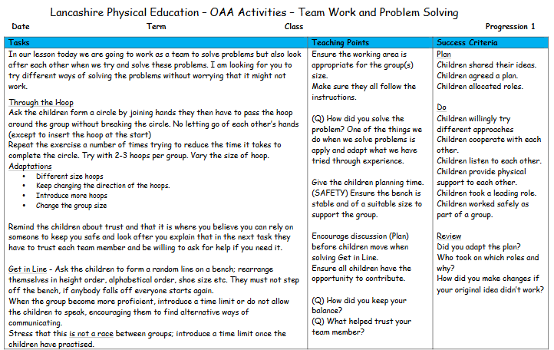
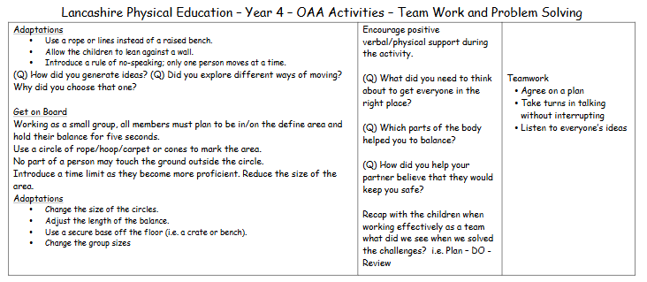
Planning
The Lancashire PE Passport provides a structured and progressive approach to planning Physical Education across Key Stage 2. It supports teachers in delivering a broad and balanced curriculum that develops pupils’ physical skills, knowledge, tactical understanding and social and emotional skills across a range of sports and physical activities. Planning builds on prior learning and provides opportunities for pupils to practise, refine and apply their skills with increasing confidence and independence. PE Passport planning is adapted to meet the needs of our learners, taking account of their individual starting points, abilities and needs. Teachers adapt activities, equipment, rules and levels of challenge to ensure that all pupils, including those with SEND, can access the curriculum and experience success. The STEP approach (Space, Task, Equipment and People) is used where appropriate to remove barriers to participation and ensure that learning is inclusive, engaging and appropriately challenging for every pupil.

Slide 12
Health and Safety
PE Kit and Jewellery
All jewellery must be removed before participating in PE lessons, in line with school health and safety procedures. Long hair must be tied back securely for all PE lessons. If a pupil arrives without a suitable hair tie, one will be provided by a member of staff.
Health and Safety
Gymnastics equipment will be inspected annually by a suitably qualified company. The Site Manager will check outdoor areas each morning for potential hazards and report any concerns.
The teacher delivering an indoor PE lesson is responsible for checking that the hall is safe and free from hazards before the lesson begins.
Teachers must ensure that apparatus is assembled, positioned and used safely. Pupils must not move or handle apparatus without appropriate supervision and instruction.
Pupils must not be given unsupervised access to the PE equipment cupboard or be responsible for managing the cupboard independently.
Any damaged or unsafe equipment must be taken out of use and reported promptly.
Accident Reporting
All accidents, injuries and significant incidents occurring during PE lessons or sporting activities must be reported promptly in accordance with the school’s accident-reporting procedures. Relevant incidents must be reported to the designated First Aid Coordinator and Headteacher, as appropriate, and recorded in the school’s accident book or approved reporting system. Any necessary follow-up action must be taken to reduce the risk of a similar incident occurring again.

Slide 13
Assessment
Assessment in PE is used to monitor pupils’ progress, identify strengths and areas for development, and inform future teaching. The Primary PE Passport supports formative and summative assessment across a range of PE units, ensuring that pupils’ holistic development is recognised rather than focusing solely on physical performance.
Formative assessment is embedded throughout lessons through teacher observation, questioning, feedback and Assessment for Learning (AfL). Teachers complete lesson evaluations on PE Passport to inform future planning and adapt teaching in response to pupils’ needs. At the end of each unit, teachers assess pupils against clear learning objectives and National Curriculum outcomes, using the Performing, Personal, Social, Health and Emotional (PSHE), and Competition categories to develop a rounded picture of pupils’ progress. Assessment takes place across a range of PE strands, including dance, gymnastics and outdoor adventurous activities.
Photographs and videos are uploaded to PE Passport to evidence pupils’ participation, skill development and achievement, supporting accurate assessment and the moderation of standards across the school. Assessment outcomes identify pupils who are exceeding expectations or require further support. Information is shared with the next class teacher to inform future planning and ensure continuity of learning. The PE Subject Leader monitors assessment information and evidence to evaluate standards, identify areas for development and inform future curriculum improvements.

Slide 14
Monitoring
Monitoring in PE is used to evaluate the quality of teaching and learning, assess the impact of the curriculum and identify areas for further development. The PE Subject Leader monitors provision across Meadowhead Juniors to ensure that the Lancashire PE Passport scheme is implemented effectively and that all pupils make progress from their individual starting points. Monitoring activities include:
Lesson visits: Observing PE lessons to evaluate teaching, learning, pupil engagement, inclusion and the development of physical skills.
Planning reviews: Reviewing PE Passport planning to ensure lessons are progressive, appropriately adapted and aligned with the National Curriculum.
Assessment monitoring: Reviewing end-of-unit assessments and teacher evaluations to evaluate pupil progress and identify strengths and areas for development.
PE Passport evidence: Checking uploaded photographs and videos to support assessment accuracy, evidence pupils’ achievement and facilitate the moderation of standards across the school.
Pupil voice: Gathering pupils’ views on their PE experiences, confidence, participation and enjoyment of physical activity.
Staff voice: Discussing curriculum delivery, resource requirements, training needs and areas where staff may require additional support.
Participation and inclusion: Monitoring pupils’ access to PE, including those with SEND, to ensure that activities are appropriately adapted and all pupils have opportunities to succeed.
Curriculum coverage: Reviewing provision across the different PE strands to ensure breadth, balance and progression throughout KS2.
Enrichment opportunities: Monitoring participation in extracurricular activities, sporting competitions and events supported by the Blackburn with Darwen School Games Organisers.
Action planning: Using monitoring findings to identify strengths, address gaps and inform the PE subject development plan and future staff training.
Monitoring outcomes are shared with senior leaders, where appropriate, to evaluate the effectiveness of PE provision and ensure continued improvement in teaching, learning and pupil outcomes.

Slide 15
Role of the Governor
The curriculum governor and education committee work with the PE Subject Leader to provide appropriate oversight and support for the subject across the school. They develop an understanding of the PE curriculum, including its progression of knowledge and practical skills, and monitor how effectively the subject is being implemented. The governor meets with the subject leader to discuss curriculum developments, strengths, areas for improvement, pupil progress, inclusion, resources and subject priorities. They may support the monitoring of PE through activities such as learning walks, reviewing curriculum documentation, discussing pupil voice and looking at examples of pupils' work.
The link governor also provides an opportunity for the subject leader to share the impact of developments and any challenges or resource needs. Through regular communication and appropriate challenge, the link governor helps governors maintain an informed understanding of the quality and impact of PE across the school.

Slide 16
Equal Opportunities
1. All pupils will have equal access to the entire PE curriculum
2. Gender, learning ability, physical ability, ethnicity, linguistic ability and/or cultural circumstances will not impede pupils from accessing all computing lessons.
3. Where it is inappropriate for a pupil to participate in a lesson because of reasons related to any of the factors outlined above, the lessons will be adapted to meet the pupil’s needs and alternative arrangements involving extra support, will be provided where necessary.
4. All efforts will be made to ensure that cultural and gender differences will be positively reflected in all lessons and teaching materials used.
5. Meadowhead Juniors aims to provide more academically able pupils with the opportunity to extend their thinking through extension activities such as providing further enquiry questions.

Slide 17
Evidence

Slide 18
Evidence

Slide 19
Evidence

