Slide 1

PSHE and RSE

Slide 2
PSHE and RSE Policy
Policy Title | PSHE and RSE Policy
Ratified by | Jason Newsham
Subject Leader | Sarah Gill
Date ratified | October 2026
Review date | October 2027
Named governor

Slide 3
Role of the Subject Leader
The KS2 PSHE Subject Leader is responsible for leading and developing the PSHE and RSE curriculum across Key Stage 2, ensuring that it is engaging, progressive, inclusive, and aligned with statutory requirements and the needs of pupils. The school has tailored the Kapow PSHE and RSE curriculum to reflect the needs, experiences and context of our children, ensuring that learning is relevant, meaningful and supports a strong sense of belonging for every pupil. They support teachers with planning, resources, and professional development, while monitoring the quality of teaching and learning through activities such as learning walks, work scrutiny, pupil voice, and assessment analysis.
The subject leader oversees the delivery of the school’s bespoke Aspiration, Equality and Diversity (AED) curriculum, ensuring that pupils have opportunities to develop their understanding of equality, diversity, inclusion, aspirations and the contributions of individuals and communities. They also ensure that the PSHE and RSE curriculum supports pupils’ personal, social, health and emotional development, including relationships, health and wellbeing, safety and citizenship. The subject leader evaluates pupil progress, identifies strengths and areas for improvement, and works with senior leaders to ensure that the curriculum reflects the needs and experiences of the school community. Through these responsibilities, they help ensure that all pupils develop the knowledge, skills, confidence and resilience needed to make informed choices, build positive relationships, respect diversity, develop a strong sense of belonging and contribute positively to their school and wider community.

Slide 4
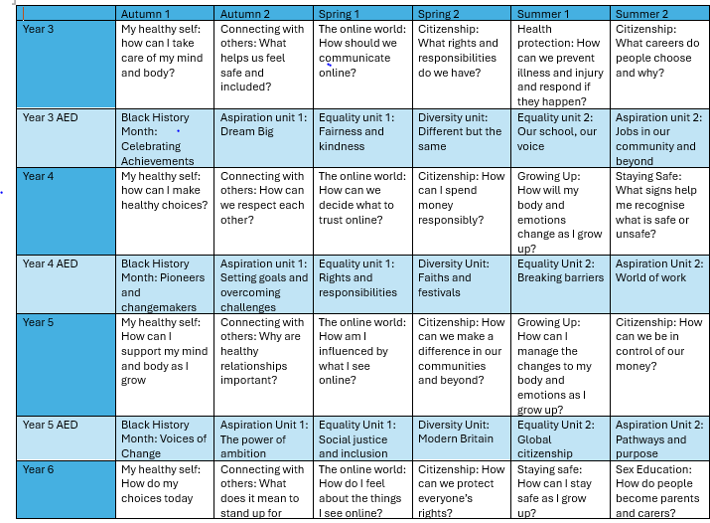

Overview

Slide 5
Intent
At Meadowhead Junior School, PSHE and RSE education is a vital part of our curriculum, supporting pupils to become confident, resilient, emotionally literate and responsible citizens. Our intention is to equip all children with the knowledge, skills and attitudes they need to lead safe, healthy and fulfilling lives.
We have tailored the Kapow Primary PSHE and RSE curriculum to reflect the needs, experiences and context of our children, ensuring that learning is relevant, meaningful and inclusive. Alongside Kapow, our bespoke Aspiration, Equality and Diversity (AED) curriculum provides opportunities for pupils to explore identity, equality, diversity, inclusion and aspirations, helping every child to recognise their value and develop a strong sense of belonging.
Our curriculum aims to:
Develop pupils’ understanding of relationships, health, wellbeing, citizenship and economic wellbeing in a structured and progressive way.
Enable pupils to build positive relationships, manage emotions, communicate respectfully and develop empathy.
Promote understanding of equality, diversity and inclusion, challenging stereotypes and celebrating differences.
Develop pupils’ aspirations and help them recognise their potential and the contribution they can make to their community and wider world.
Provide honest, factual and age-appropriate information about puberty, relationships and growing up, enabling pupils to make informed and safe choices.
Develop the knowledge, vocabulary and confidence needed to keep themselves safe, including understanding risks, protective behaviours, online safety and when and how to seek help.
Build pupils’ self-worth, resilience and emotional wellbeing, supporting them to manage challenges and make positive choices.
Ensure that all pupils feel represented, respected, valued and that they belong within their school, community and wider society.
By the end of KS2, pupils will be well prepared for the challenges and opportunities of adolescence and secondary education. They will have the knowledge, confidence and resilience to make informed decisions, maintain positive relationships, respect diversity, recognise risks, keep themselves safe and seek help when needed.

Slide 6
Implementation
Our PSHE and RSE curriculum is delivered through the Kapow Primary Key Stage 2 scheme of work, which we have tailored to reflect the needs, experiences and context of our children. This provides a consistent, progressive and inclusive approach across the school, alongside our bespoke Aspiration, Equality and Diversity (AED) curriculum.
The curriculum is implemented through:
A progressive and structured curriculum covering Families and Relationships, Health and Wellbeing, Safety and the Changing Body, Citizenship and Economic Wellbeing. Learning is revisited and developed over time, building on prior knowledge and preparing pupils for future learning.
Weekly, high-quality lessons taught by class teachers, with clear learning objectives, explicit vocabulary, discussion, scenarios and age-appropriate activities.
A safe and inclusive environment where ground rules and respectful discussion enable pupils to explore sensitive issues confidently. Lessons are adapted to meet the needs of all learners, including pupils with SEND.
Active and engaging teaching approaches, including discussion, role-play, scenarios, problem-solving, reflection and real-life contexts. Pupils have opportunities to practise decision-making, communication, empathy, resilience and critical thinking.
Our bespoke AED curriculum, which develops pupils’ understanding of aspiration, equality, diversity and inclusion. This helps children recognise their own potential, understand and celebrate differences, challenge stereotypes and develop a strong sense of belonging.
A strong focus on keeping safe, including relationships, personal safety, protective behaviours, online safety, digital resilience, puberty and recognising when and how to seek help.
Links across the wider curriculum and school life, including Science, Computing, PE, assemblies, themed weeks and enrichment opportunities, allowing pupils to apply their learning in meaningful contexts.
Assessment and monitoring, using Kapow assessment opportunities, teacher observation, questioning, pupil voice and review of pupils’ work. Subject leaders monitor coverage, progression, inclusion and the quality of provision through planning scrutiny, learning walks, staff feedback and pupil voice.

Slide 7
Impact
Through our carefully structured and inclusive PSHE and RSE curriculum, pupils leave Key Stage 2 with the knowledge, skills, confidence and resilience needed to navigate an increasingly complex world. The impact of our curriculum is seen in pupils who:
Demonstrate confidence, self-awareness, resilience and emotional literacy.
Develop positive relationships and show respect, empathy and understanding towards others.
Understand how to support their physical and mental health and wellbeing.
Recognise risks, know how to keep themselves safe, including online, and understand when and how to seek help.
Have an age-appropriate understanding of puberty, relationships, personal boundaries and body changes.
Make informed and responsible decisions and understand the impact of their choices.
Understand and respect equality, diversity and inclusion, while challenging stereotypes.
Develop a strong sense of belonging, recognising that they are valued members of their school, community and wider society.
Develop positive aspirations and recognise their own strengths, potential and ability to contribute.
Understand their rights and responsibilities and develop an emerging understanding of financial and economic wellbeing.
Are well-prepared for secondary school, with the knowledge and personal skills needed to make positive choices.

Slide 8
Impact
We measure impact through:
Pupil voice and assessment of knowledge, understanding and confidence.
Teacher assessment, questioning and reflection.
Evidence in class books, floor books and pupil outcomes.
Monitoring of curriculum coverage and progression.
Behaviour, wellbeing and safeguarding information, where appropriate.
Feedback from parents, staff and relevant external agencies.
Ultimately, our PSHE and RSE provision, supported by Kapow and our bespoke Aspiration, Equality and Diversity (AED) curriculum, enables pupils to become safe, confident, respectful and resilient individuals who feel valued, develop a strong sense of belonging and are equipped to make positive choices and contribute to society.

Slide 9
Teaching and Learning
All learners, regardless of their individual starting point, will have access to the PSHE and RSE curriculum and it is for each teacher to adapt their teaching to enable this. To facilitate learning in PSHE and RSE, it is considered good practice to ensure that:
• The purpose of each lesson is made clear and pupils understand the knowledge, skills or personal development focus being explored.
• Appropriate learning experiences are planned to meet the needs of all pupils in the class (see inclusion below and our SEND Policy), building on pupils’ existing knowledge, experiences and understanding.
• Lessons provide opportunities for pupils to learn, practise and apply knowledge and skills through discussion, questioning, scenarios, role-play, reflection and real-life contexts.
• The Kapow PSHE and RSE curriculum is adapted to reflect the needs and experiences of our children, ensuring that learning is relevant, meaningful and supports pupils to develop a strong sense of belonging.
• Our bespoke Aspiration, Equality and Diversity (AED) curriculum provides opportunities for pupils to explore identity, equality, diversity, inclusion and aspirations, helping pupils recognise their own value and the value of others.
• Vocabulary is explicitly taught, modelled and revisited so that pupils can confidently discuss relationships, health, safety, emotions, diversity and other sensitive topics.
• Time is given for pupils to reflect, consolidate and apply their learning to real-life situations, including making safe choices, recognising risks and knowing when and how to seek help.
• Pupils are encouraged to take responsibility for their own learning and personal development, reflecting on their choices, relationships, wellbeing, aspirations and progress.
• Attention is given to developing a safe, respectful and inclusive classroom climate, where pupils feel comfortable asking questions, sharing ideas and discussing sensitive issues appropriately.
• Staff training and support needs are identified and met to ensure teachers have the confidence and subject knowledge to deliver PSHE and RSE effectively and sensitively.
• Links with wider school life, including assemblies, themed weeks, safeguarding education, Computing, Science and PE, are used to reinforce learning and help pupils apply their knowledge beyond the classroom.

Slide 10
Inclusion
All learners, regardless of their individual starting point, will have access to the PSHE and RSE curriculum and it is for each teacher to adapt their teaching to enable this. The Kapow PSHE and RSE curriculum has been tailored to reflect the needs, experiences and context of our children, ensuring that learning is relevant, accessible and meaningful for all pupils.
Pre-teach and reinforce PSHE and RSE vocabulary using visual word mats, symbols, child-friendly definitions and repetition to support pupils in understanding and confidently using key terminology related to relationships, emotions, health, safety, puberty and diversity.
Break down sensitive or complex topics into small, manageable steps using clear explanations, visual resources, stories, scenarios, modelling and structured questioning. Teachers provide appropriate opportunities for pupils to process information and ask questions in a safe and supportive environment.
Use visual and practical supports throughout Kapow units, including images, diagrams, social stories, scenario cards, emotion scales, sorting activities and visual prompts to help pupils access and understand key concepts.
Provide scaffolded versions of activities using sentence stems, writing frames, discussion prompts, matching and sorting activities, choice boards and partially completed tasks to reduce cognitive demands while maintaining the intended learning objectives.

Slide 11
Inclusion
Adapt learning for pupils with SEND, including additional processing time, simplified or symbol-supported resources, repetition, adult or peer support and alternative ways of recording learning where appropriate.
Ensure all pupils feel represented and valued through our bespoke Aspiration, Equality and Diversity (AED) curriculum, providing opportunities to explore different identities, backgrounds, experiences and achievements while developing respect, empathy and understanding.
Develop a strong sense of belonging and personal safety by creating a safe, inclusive classroom environment where pupils understand that their voice matters, know how to recognise risks, understand protective behaviours and know when and how to seek help.
Maintain appropriate boundaries around sensitive content, ensuring that teaching is age-appropriate, respectful and responsive to individual needs and circumstances, while following school safeguarding procedures and relevant policies.

Slide 12
RSHE
Statutory RSHE Requirements – September 2026
From 1 September 2026, Meadowhead Juniors must have regard to the revised Department for Education statutory guidance for Relationships Education, Relationships and Sex Education and Health Education (RSHE). For primary pupils, Relationships Education and Health Education are statutory. Primary schools are not required to teach Sex Education beyond the statutory content within the Science curriculum, although schools may choose to provide additional, age-appropriate sex education.

Slide 13
RSHE
Our PSHE and RSE curriculum has been reviewed and tailored to meet these statutory requirements while reflecting the needs and experiences of our pupils. The curriculum provides progressive learning about:
Families and relationships, including respectful and healthy relationships, friendships, family life, kindness and recognising inappropriate or unsafe behaviour.
Online and offline safety, including recognising risks, seeking help and developing safe and responsible behaviours.
Mental and physical health and wellbeing, including emotional wellbeing, healthy lifestyles and where to seek support.
Growing and changing, including age-appropriate learning about puberty and the physical and emotional changes pupils may experience.
Personal safety and protective behaviours, enabling pupils to recognise when something is not right, establish appropriate boundaries and know how to seek help from trusted adults.
Equality, diversity and respect, supporting pupils to understand and respect differences and develop positive relationships with others.

Slide 14
RSHE
Teaching is age-appropriate, inclusive and sensitive to pupils' needs and backgrounds, with teachers adapting provision where necessary. The statutory guidance requires schools to consider pupils' age, developmental stage and religious background when delivering Relationships Education.
Meadowhead Juniors also recognises parents' rights in relation to Sex Education taught beyond the statutory Science curriculum.
Parents have the right to request that their child is withdrawn from additional primary sex education, while there is no right to withdraw from statutory Relationships Education or the Science curriculum.
Our approach ensures that pupils receive the statutory knowledge and understanding they need to develop safe, healthy and respectful relationships, protect their wellbeing, recognise risks, seek help when needed and develop the confidence and knowledge to make informed choices as they move towards adolescence and secondary education.

Slide 15
RSHE
Year 3 Statutory Guidance:
Pupils develop the foundations for safe, healthy and respectful relationships, including:
Different types of families and the importance of caring relationships.
Characteristics of positive friendships, kindness, respect and inclusion.
Managing emotions, disagreements and friendship difficulties.
Recognising bullying and knowing how to seek help.
Personal boundaries, privacy and respecting the boundaries of others.
Understanding that their body belongs to them and identifying trusted adults.
Recognising and reporting situations that make them feel unsafe.
Developing emotional vocabulary and strategies for supporting wellbeing.
Healthy lifestyles, including physical activity, sleep, nutrition and personal hygiene.

Slide 16
RSHE
Year 4 Statutory Guidance:
Pupils build on these foundations by developing their understanding of:
Respectful relationships, communication and managing conflict.
Different families, identities and experiences, promoting equality, diversity and belonging.
Stereotypes, discrimination and how these can affect others.
Online relationships, privacy, personal information and respectful online behaviour.
Recognising unsafe or inappropriate behaviour and knowing how to report concerns.
Mental wellbeing, loneliness, bullying and where to seek support.
Healthy eating, physical activity, sleep and personal health.
Personal safety, including recognising hazards and reducing risk.
Basic first aid and how to make an effective emergency call.

Slide 17
RSHE
Year 5 Statutory Guidance:
Pupils develop greater knowledge and independence in preparation for adolescence, including:
Healthy friendships, relationships, boundaries and respectful communication.
Recognising pressure, controlling behaviour and situations that may be unsafe.
Online safety, harmful content, privacy, sharing information and seeking help.
Developing resilience, self-worth, emotional awareness and positive mental health.
The physical and emotional changes associated with puberty and growing up.
The menstrual cycle and understanding menstruation in an inclusive and sensitive way.
Correct terminology for body parts and understanding privacy and personal boundaries.
Making informed choices about health, nutrition, physical activity and sleep.
Understanding the risks associated with harmful substances and making safe choices.
Recognising risks in everyday life, including around roads, railways and water.

Slide 18
RSHE
Year 6 Statutory Guidance:
Pupils consolidate and apply their learning as they prepare for secondary school, including:
Maintaining positive and respectful relationships and managing more complex friendship situations.
Understanding consent, personal boundaries and the importance of respecting others' choices.
Recognising harmful, abusive or exploitative behaviour and knowing how to seek help.
Developing confidence in responding to peer pressure and making safe decisions.
Online relationships, age restrictions, privacy, harmful content, scams and reporting concerns.
Understanding how online behaviour can affect wellbeing and relationships.
Developing emotional resilience and knowing when and how to seek support for mental wellbeing.
Understanding the changes of puberty and adolescence, including physical and emotional changes.
Understanding the human lifecycle, reproduction and conception in line with the statutory Science curriculum.
Developing knowledge of personal safety, including recognising and responding to risks in increasingly independent situations.
Basic first aid and responding appropriately to emergencies.
Developing financial awareness, responsible decision-making and preparation for increased independence.

Slide 19
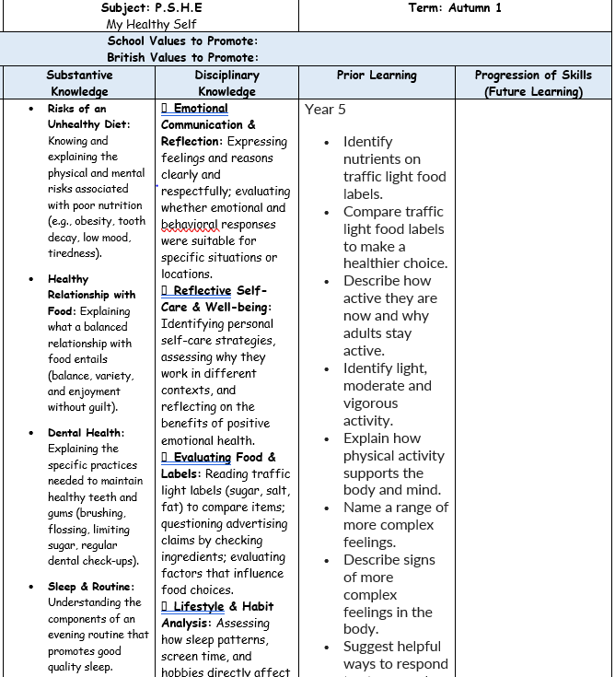
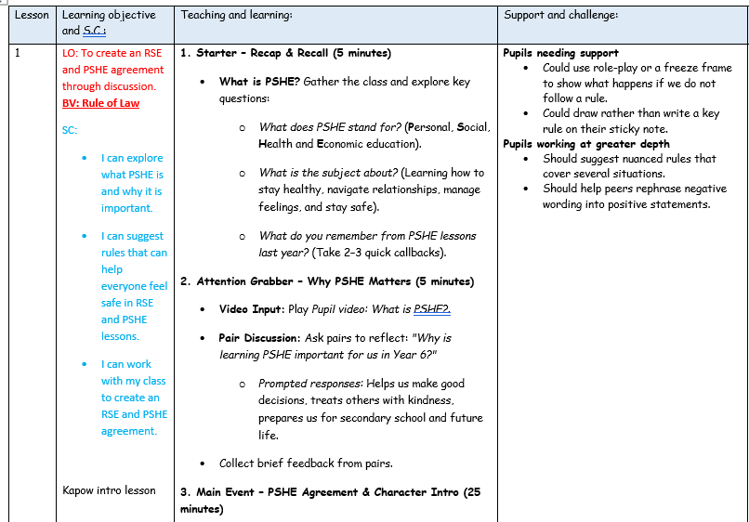
Planning
Planning follows the KAPOW scheme of work, our bespoke AED curriculum and is adapted for each class. NC links, substantive and disciplinary knowledge, prior and future learning are identified. Key vocabulary, outcomes and cross-curricular links are also identified.
Each lesson is broken down into easy-to-follow steps, adapted for the class needs with clear learning objectives, success criteria and key adaptation.

Slide 20
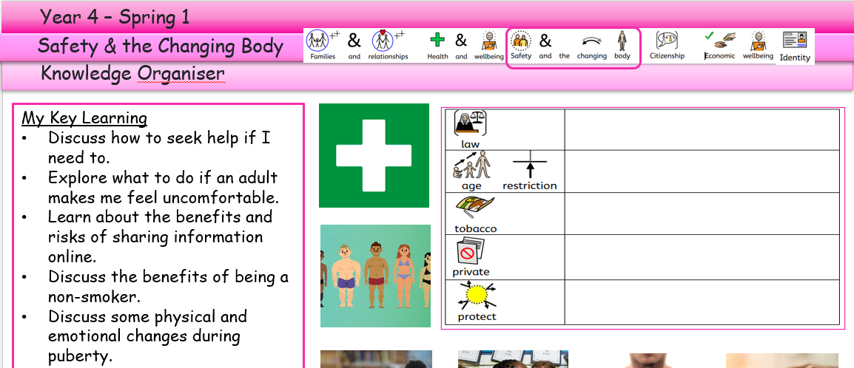
Planning
Knowledge organisers are used to support pupils in remembering and revisiting the key knowledge, vocabulary and concepts from a unit of work. They provide a clear and accessible summary of the most important learning, helping pupils to make connections between new and prior knowledge. Knowledge organisers also support retrieval practice, independent learning and home-school communication, ensuring that all pupils, including those with SEND, have a consistent reference point throughout their learning journey.
Key learning is noted around the knowledge organiser.

Slide 21
Assessment
Assessment in KS2 PSHE and RSE is an ongoing process that helps teachers identify pupils’ knowledge, understanding and development of personal, social, health and relationship skills. Through questioning, discussion, observation, pupil reflection and practical activities, teachers gather evidence of learning and adapt teaching to meet pupils’ needs.
The Kapow PSHE and RSE scheme supports assessment through end-of-unit assessment quizzes, which provide a structured opportunity to check pupils’ knowledge and understanding of key concepts, vocabulary and learning. These quizzes help teachers identify strengths, misconceptions and gaps in knowledge, enabling areas to be revisited or consolidated where necessary.
Kapow quizzes are used alongside teacher assessment, questioning, pupil voice, self-assessment and evidence in books or floor books to build a clear picture of pupils’ progress. Assessment considers pupils’ ability to recall and apply knowledge, communicate their ideas, recognise risks, make safe and responsible choices, develop positive relationships and reflect on their own wellbeing and personal development.
Our bespoke Aspiration, Equality and Diversity (AED) curriculum also provides opportunities to assess pupils’ understanding of equality, diversity, inclusion, aspirations and belonging, including their ability to recognise and respect different experiences and perspectives.
Teachers use assessment information, including outcomes from Kapow assessment quizzes, to provide appropriate support and challenge and to inform future planning. This ensures that pupils make progress from their individual starting points and that key knowledge is revisited and secured.
Assessment in PSHE and RSE is primarily used to support learning and personal development, ensuring that pupils develop the knowledge, skills, confidence and resilience needed to make informed choices, keep themselves safe, build positive relationships and develop a strong sense of belonging.

Slide 22
Monitoring
• Learning walks and lesson observations.
• Pupil voice interviews and surveys.
• Work scrutiny of PSHE and RSE books, floor books and pupil outcomes.
• Analysis of assessment information, including Kapow end-of-unit assessment quizzes.
• Review of curriculum coverage and progression across PSHE and RSE.
• Scrutiny of teacher planning and implementation of the tailored Kapow PSHE and RSE curriculum.
• Monitoring of the bespoke Aspiration, Equality and Diversity (AED) curriculum and its impact on pupils' understanding of equality, diversity, aspirations and belonging.
• Monitoring of statutory Relationships Education and Health Education provision.
• Monitoring of safeguarding, personal safety, online safety and protective behaviours within the curriculum.
• Staff voice and confidence surveys.
• Monitoring of SEND adaptations and accessibility within PSHE and RSE lessons.
• Evaluation of resources, enrichment opportunities and links with wider school life.
• Reporting findings and identifying strengths and areas for development with senior leaders and governors.

Slide 23
Safeguarding
Our PSHE and RSE curriculum plays a vital role in promoting safeguarding, personal safety and a sense of belonging for all pupils. Through carefully planned units such as My Healthy Self, Connecting with Others, The Online World, Growing Up, Staying Safe and Sex Education, pupils develop the knowledge, skills and confidence needed to make safe choices, build healthy relationships, manage risk and seek help when needed. Learning about online communication, digital literacy and the influence of online content helps children recognise and respond to online risks, whilst units focusing on rights, responsibilities, equality and diversity encourage respect for others, challenge stereotypes and promote inclusion. This supports the British Values by fostering critical independent thinking, resilience, mutual respect and an understanding of life in modern Britain. Alongside this, our bespoke Aspiration, Equality and Diversity (AED) curriculum further strengthens safeguarding by empowering pupils to value diversity, celebrate differences, develop a strong sense of belonging and understand their rights and responsibilities within society.

Slide 24
Safeguarding
Through exploring themes such as equality, social justice, leadership, aspiration and global citizenship (along with our school values of respect, friendship, ambition, teamwork and kindness), pupils learn to challenge prejudice, respect different viewpoints and become responsible, informed members of their communities. Across the year, curriculum learning is enhanced through whole-school events and national awareness campaigns, including Safer Internet Day, Anti-Bullying Week, Children's Mental Health Week, Black History Month, Mental Health Awareness Week and other relevant safeguarding initiatives. These opportunities reinforce key messages around personal safety, wellbeing, equality, respect, positive relationships and responsible citizenship, ensuring that safeguarding remains a central thread throughout pupils' education.

Slide 25
Role of the Governor
The curriculum governor and education committee play an important role in supporting and monitoring the quality of PSHE and RSE education across KS2 at Meadowhead Juniors.
Working alongside the PSHE Subject Leader, the governor gains an understanding of how the curriculum is implemented, the progress pupils are making, and how statutory requirements are being met. This may involve reviewing subject leader reports, discussing assessment information, visiting the school to meet pupils and staff, and monitoring the impact of curriculum developments.
The role is not to evaluate individual teachers, but to provide strategic oversight, offer support and challenge where appropriate, and report back to the governing board to ensure that PSHE and RSE remains a high-quality and effective part of the curriculum.

Slide 26
Equal Opportunities
1. All pupils will have equal access to the entire PSHE and RSE curriculum
2. Gender, learning ability, physical ability, ethnicity, linguistic ability and/or cultural circumstances will not impede pupils from accessing all PSHE lessons.
3. Where it is inappropriate for a pupil to participate in a lesson because of reasons related to any of the factors outlined above, the lessons will be adapted to meet the pupil’s needs and alternative arrangements involving extra support, will be provided where necessary.
4. All efforts will be made to ensure that cultural and gender differences will be positively reflected in all lessons and teaching materials used.
5. Meadowhead Juniors aims to provide more academically able pupils with the opportunity to extend their thinking through extension activities such as providing further enquiry questions.

Slide 27
Evidence

Slide 28
Evidence

